Slide 1
OPEN DATA – LINK IT!
Dr Armin Haller
Senior Lecturer, ANU Chair, Australian Government Linked Data Working Group

Slide 2
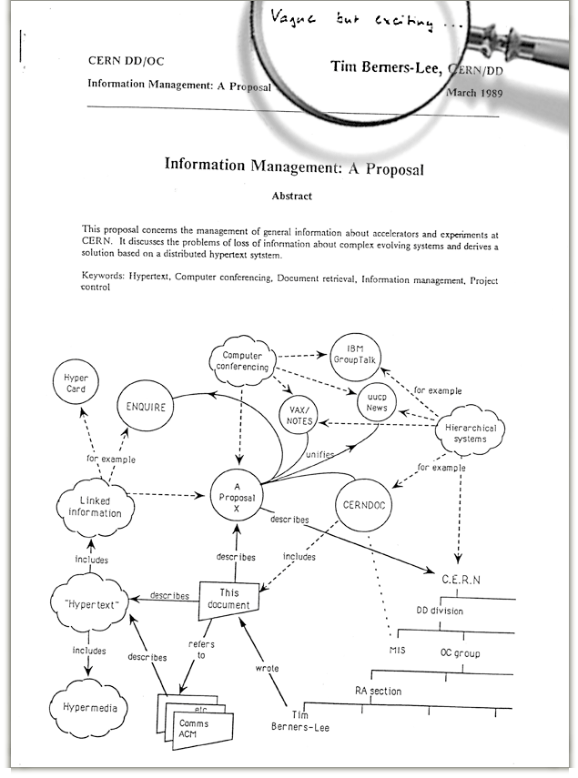
WORLD WIDE WEB (WWW)
Sir Tim Berners-Lee’s original Proposal of the World Wide Web in 1989 included “link relations” …
describes
includes

Slide 3
… but the WWW used only one type of link relation (hyperlinks) for years …

Slide 4
… until LINKED DATA
Sir Tim Berners-Lee (again) published a design-note in 2006 on Linked Data

Slide 5
What is LINKED DATA?

Slide 6
LINKED DATA
Structured Content → Linked
Understandable to humans and machines (machine-readable)
Discoverable
Reusable and Shareable
Presentable

Slide 7
LINKED DATA PRINCIPLES
Identify ‘THINGS’
Make ‘THINGS’ available online
Provide machine-readable information
Include links to other ‘THINGS’

Slide 8
1. IDENTIFY ‘THINGS’
URI – Uniform Resource Identifier
Compact sequence of characters …
… identifies an abstract or physical resource
[RFC3986]
Linked Data → URI = URL https://data.naa.gov.au/def/agift/Communications-infrastructure

Slide 9
1. IDENTIFY ‘THINGS’
Identifying and naming real-world and abstract ‘THINGS’ with URIs is extremely powerful, because:
it does not require any up-front agreement as you are the owner of that URI
others can reuse the URI and make further/other statements about that ‘THING’

Slide 10
1. IDENTIFY ‘THINGS’
Government agencies already keep lists of identifiers for ‘THINGS’ they are responsible for
URIs are required for ‘THINGS’
People, places, companies, products, roads, hospitals, schools, events, natural resources, etc.
e.g. ‘AU239’ Sample stored at Geoscience Australia
uses unique identifier (URI = URL): http://pid.geoscience.gov.au/sample/AU239

Slide 11
2. MAKE ‘THINGS’ AVAILABLE ONLINE
Put information about these ‘THINGS’ on your website
i.e. when you type …
http://pid.geoscience.gov.au/sample/AU239
… in your browser you should get some information about Sample AU239

Slide 12
3. PROVIDE MACHINE-READABLE INFORMATION
Use knowledge representation languages (e.g. RDF/OWL) to …
… make statements about resources (‘THINGS’) in the form of Subject–Predicate–Object expressions:
http://pid.geoscience.gov.au/sample/AU239
a
http://def.seegrid.csiro.au/ontology/om/sam-lite#Specimen
CurrentLocation
GA Services building
Subject | Predicate | Object
http://pid.geoscience.gov.au/sample/AU239 | a | http://def.seegrid.csiro.au/ontology/om/sam-lite#Specimen
http://pid.geoscience.gov.au/sample/AU239 | currentLocation | GA Services building

Slide 13
3. PROVIDE MACHINE-READABLE INFORMATION
Assign meaning to ‘THINGS’ through ontologies (vocabularies)
set of concepts (shared objects)
relationships between those concepts (shared predicates)
e.g. SAM-Lite ontology http://def.seegrid.csiro.au/ontology/om/sam-lite
“Specimen” Concept
URI – http://def.seegrid.csiro.au/ontology/om/sam-lite#Specimen
”A Specimen is a physical sample, obtained for observation(s) normally carried out ex-situ, sometimes in a laboratory.”
A perspective of the concept via attributes / properties: class of material, current location, sampling elevation, sampling location, sampling method, sampling time, specimen size …

Slide 14
4. INCLUDE LINKS
Identifying things with URIs works best when everyone uses the same URI to mean the same ’THING’
In practice, that generally means you still define your own URI for a ‘THING’, but link to a URI describing a similar ‘THING’
http://def.seegrid.csiro.au/ontology/om/sam-lite#Specimen
rdfs:subClassOf
http://www.w3.org/ns/sosa/Sample

Slide 15
Who is using it?

Slide 16
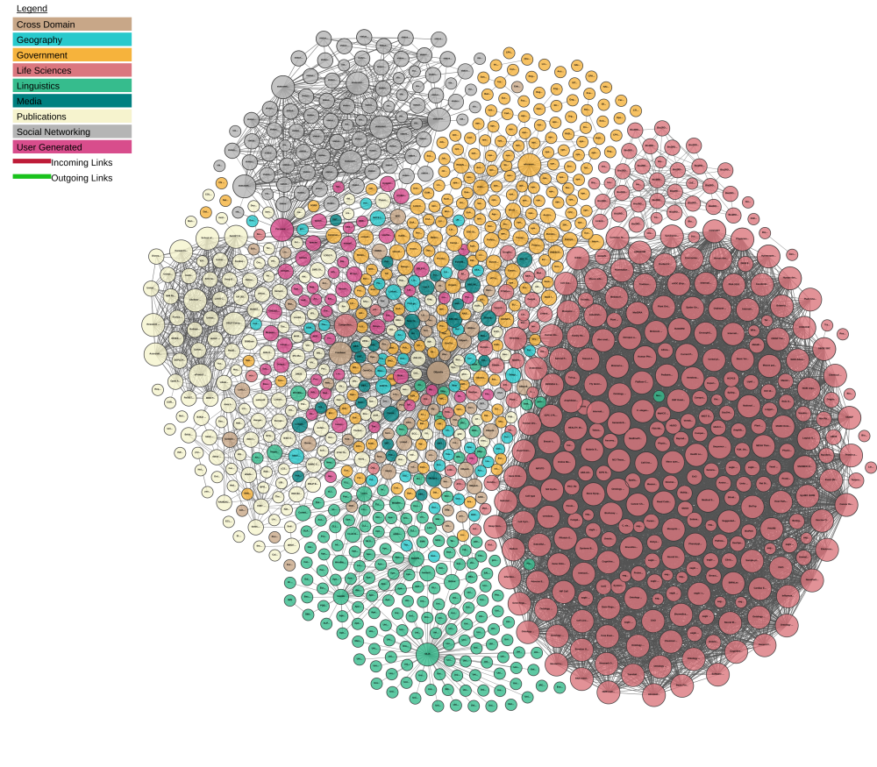
LINKED DATA CLOUD

Slide 17
… but is it largely an academic exercise?

Slide 18
Yes it was, until SCHEMA.ORG
In 2011, the major search engines Google, Bing ,Yahoo, and (later) Yandex created Schema.org
Single vocabulary (ontology) across a wide range of topics
Includes classes/properties for people, places, events, products, offers, …

Slide 19
SCHEMA.ORG
One vocabulary understood by all search engines
Website owners benefit from using schema.org
700+ concepts like Place, People, Offer
~10s for most sites
~10ks of terms like Canberra
~1b-100b terms like iPhone 7, PlayStation 4
Cannot expect agreement on these
Users can reconcile entity references
CivicInfrastructure
type
Park
Canberra
type
containedInPlace
Commonwealth Park
openingHours
24 hours 7 days
Source: R.V. Guha, D. Brickley, S. Macbeth (2016). Schema.org: evolution of structured data on the web. CACM 59:2, Feb. 2016

Slide 20
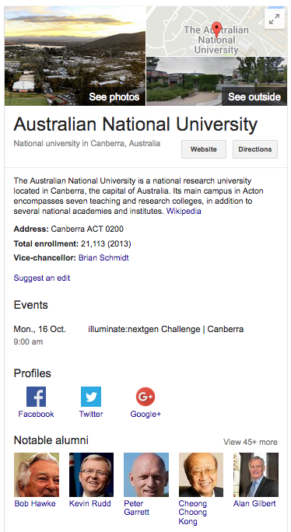
SCHEMA.ORG
Enables:
Knowledge Panels
Rich Snippets

Slide 21
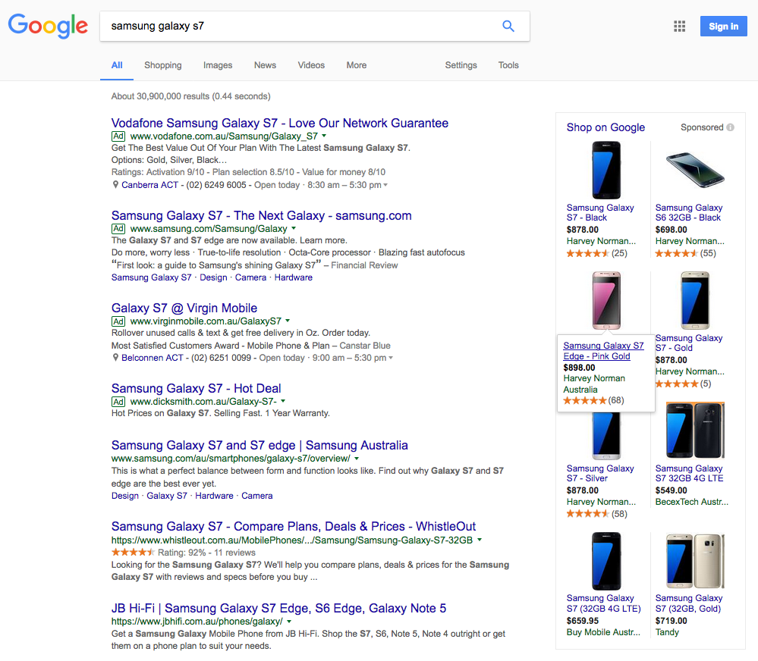
SCHEMA.ORG
Google Rich Snippets Product Search
Structured Information from provider included in search result

Slide 22
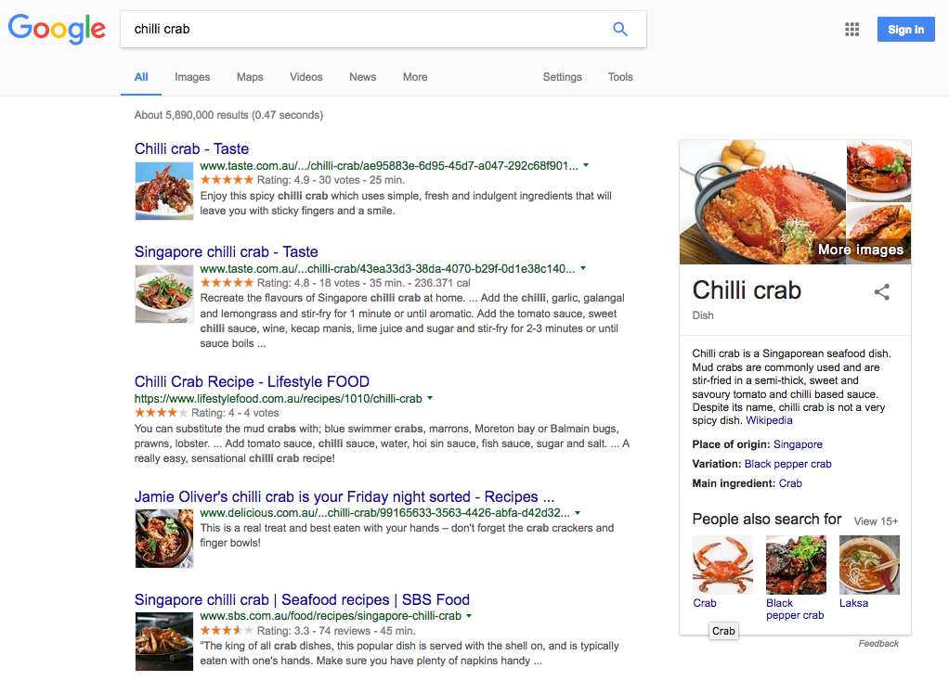
SCHEMA.ORG
Google Rich Snippets Recipe Search
Structured Information from provider included in search result

Slide 23
SCHEMA.ORG
As a result, schema.org is used by more than 30% of all websites:
News: Nytimes, guardian.com, bbc.co.uk,
Movies: imdb.com, rottentomatoes.com, movies.com
People: linkedin.com,
Products: ebay.com, alibaba.com, sears.com,
Videos: youtu.be, dailymotion.com, frequency.com, vinebox.com
Events: meetup.com, zillow.com
Music: last.fm, myspace.com
Source: R.V. Guha, D. Brickley, S. Macbeth (2016). Schema.org: evolution of structured data on the web. CACM 59:2, Feb. 2016

Slide 24
… and Governments need to use Linked Data and schema.org too!

Slide 25
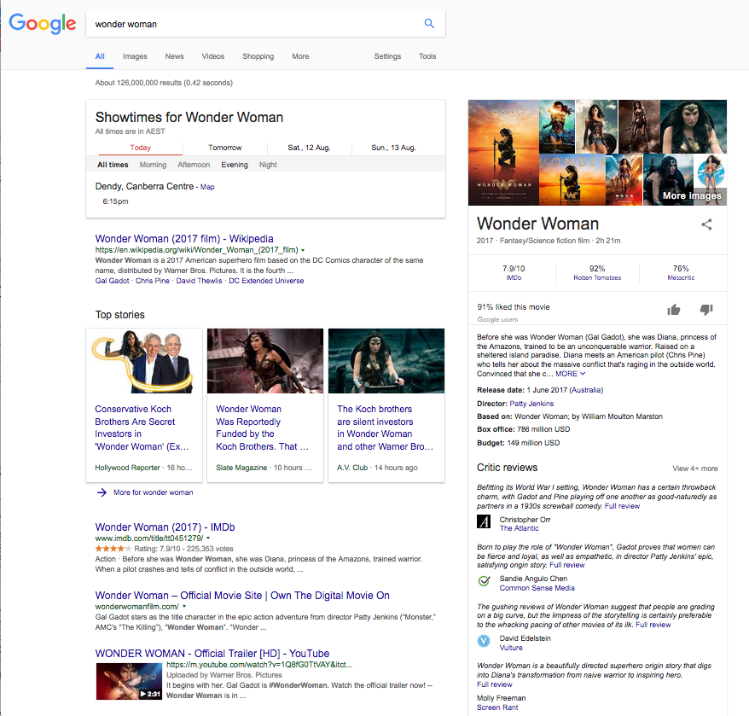
Looking to go to the cinema?

Slide 26
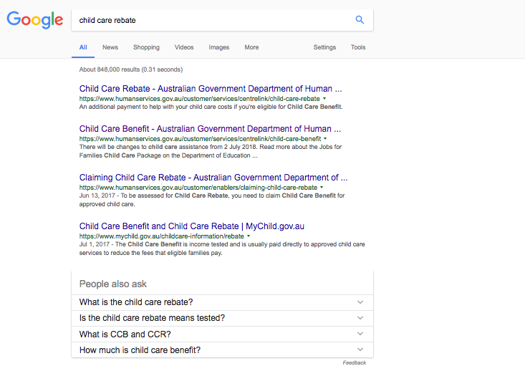
Looking for child care benefit?
?

Slide 27
PROVIDE STRUCTURED INFORMATION ABOUT ‘THINGS’?
Governments need to provide structured information about their data/services
The concept of, e.g. a ‘GovernmentService’ http://schema.org/GovernmentService (or ‘Road’, ‘Hospital’, ‘Public Infrastructure’ etc.)
‘Government service’ attributes, such as a ‘serviceOperator’
A specific ‘GovernmentService’, e.g. ‘Child Care Benefit’ and its attributes, e.g.:
serviceOperator: Department of Human Services
areaServed: Australia
isRelatedTo: Family Tax Benefit
…

Slide 28
USE GOVERNMENT WIDE URIS FOR ‘THINGS’
URIs are cool if they are:
Readable
http://environment.data.gov.au/weather/000478 → http://environment.data.gov.au/weather/id/station/000478
Unambiguous
http://location.data.gov.au/id/carlton → http://location.data.gov.au/id/vic/carlton
Include no implementation details
http://education.data.gov.au/index.php?type=school&id=2600 → http://education.data.gov.au/id/school/2060
Maintained! → even if content moves or is deleted (e.g. MoG), server should respond appropriately
… and broken links are uncool

Slide 29
AUSTRALIAN GOVERNMENT LINKED DATA WORKING GROUP
Community of Commonwealth Government experts and champions, with invited non-voting participation of individuals, corporations and other entities to:
Establish technical guidance publishing public sector information using Linked Data as a delivery technology
Determine governance rules and processes for the effective management of Australian Government Linked Data
Promote Linked Data across the Australian Government
Engender the development of Linked Data infrastructure
http://linked.data.gov.au/

Slide 30
URI GUIDELINES
Index of a Dataset: Identifier that names a Linked dataset and provides metadata of the dataset.
Real-world ‘Things’ Identifier: Physical and abstract ‘Things’ that may be referred to in statements.
Document Identifier: Information on the web about Real World ‘Things’
Vocabulary identifiers (ontologies, concepts etc.): URIs for classes and properties describing real-world things
/dataset[/{module}]*/{datasetid} → /dataset/act/schools [Metadata for School Dataset]
/id/{type}/{name} → /id/school/2060 [Canberra Grammar]
/doc/{type}/{name} → /doc/school/2060 [Document about Canberra Grammar]
/def/{scheme}/{concept} → /def/school/phaseOfEducation [Class definition]

Slide 31
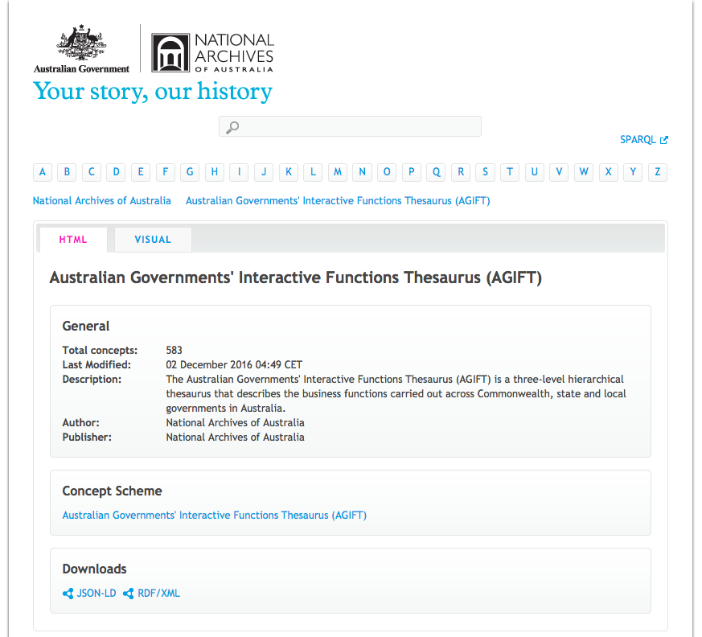
Australian Governments’ Interactive Functions Thesaurus (AGIFT)
Published by National Archives
Used to classify Linked Datasets in the AGLDWG URI guidelines
https://data.naa.gov.au/def/agift.html

Slide 32
Questions?
http://linked.data.gov.au
https://github.com/AGLDWG

