Slide 1
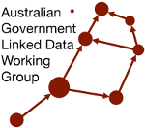
How can you contribute to the W3C and the AGLDWG?
Dr Armin Haller
Co-Chair AGLDWG, Office Manager W3C Australia
Senior Lecturer, ANU

Slide 2
ABOUT W3C: “LEADING THE WEB TO ITS FULL POTENTIAL”
Founded 1994; celebrating 25 years
Membership organization with more than 400 members
70 staff in US (MIT), China (Beihang), France (ERCIM) and Japan (Keio)
Focus on Web ecosystem: users, developers, browsers, etc.
Developing new technologies for Open Web Platform that are transforming industries like Mobile, Entertainment, Automotive, Digital Publishing, Web Payments and Manufacturing (Web of Things)
W3C focuses both on the Open Web, as well as specific industry requirements brought by industry segments
Tim Berners-Lee
WEB INVENTOR AND
W3C DIRECTOR

Slide 3
W3C DEVELOPS ROYALTY-FREE STANDARDS
Standard platform levels playing field; reduces development costs
Level playing field enables greater, faster innovation
Participation allows organizations to shape platform, ensure their needs are met, standardize best practices across complex eco-systems
Participants gain early access to insights and successful standards implementations

Slide 4
GLOBAL PARTICIPATION
 | 2014 | 2015 | 2016 | 2017
Members | 406 | 405 | 427 | 471
Full | 86 | 94 | 95 | 87
Community& Business Groups / People | 180 >4.4K | 225 >6.3K | 251 >7.4K | 292 > 9K
Students enrolled in W3C courses | 2.6K | 48K | 300K | 600K

Slide 5
WORKING GROUPS
W3C has at any point 20+ open working groups (e.g. CSS, Web Authentication, Automotive, Web of Things etc.)
Relevant open working groups:
Dataset Exchange Working Group
Web of Things Working Group
Spatial Data on the Web (SDW) Interest Group

Slide 6
SDW INTEREST GROUP
Joint W3C/OGC interest group
Builds upon the outcomes of the Spatial Data on the Web Working Group
The Spatial Data on the Web IG is scoped to realize the W3C side of the Joint W3C/OGC Organizing Committee (JWOC), i.e.:
to facilitate direct cooperation between the spatial information and Web communities, allowing each to benefit from the other's data, technologies and methods.
to publish joint work where appropriate and may recommend the creation of formal standards-defining working groups where necessary in one or both standards development organizations.

Slide 7
SDW WORKING GROUP
Was chartered to:
determine how spatial information can best be integrated with other data on the Web;
determine how machines and people can discover that different facts in different datasets relate to the same place, especially when 'place' is expressed in different ways and at different levels of granularity;
identify and assess existing methods and tools and then create a set of best practices for their use;
complete the standardization of informal technologies already in widespread use.
https://www.w3.org/2015/spatial/charter

Slide 8
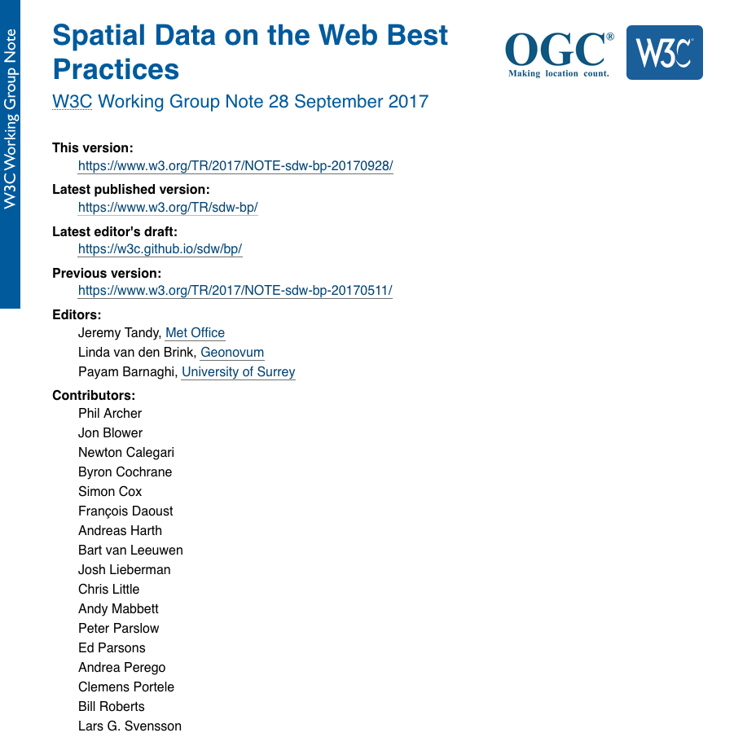
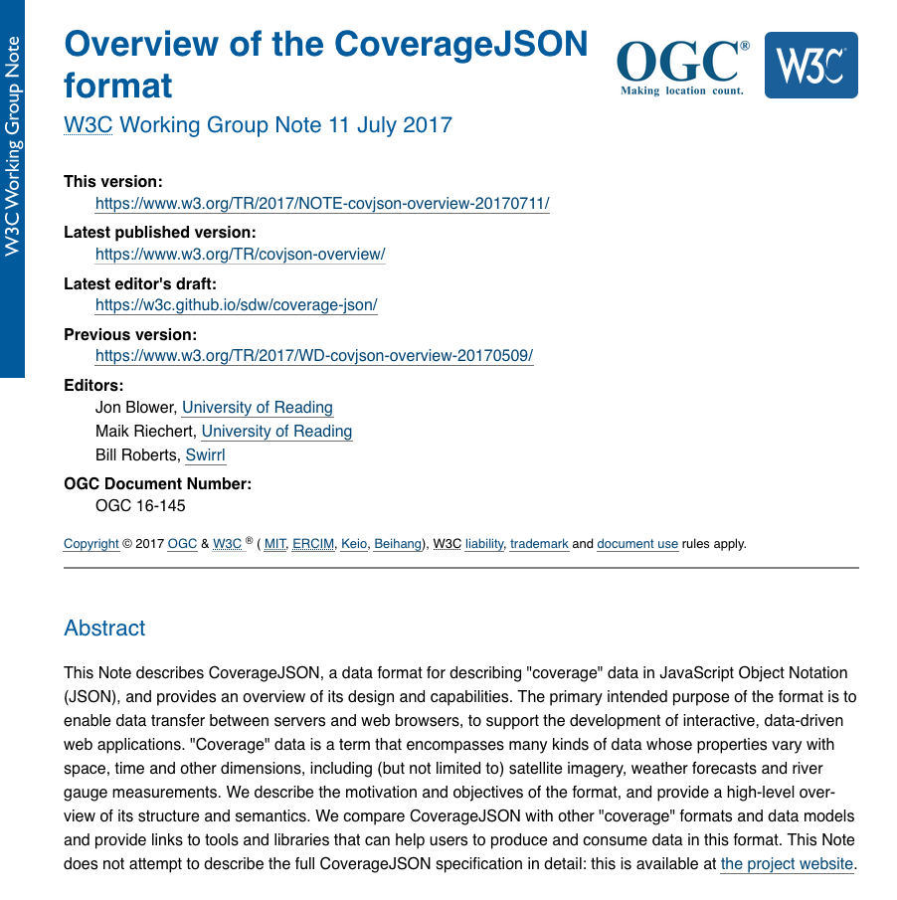
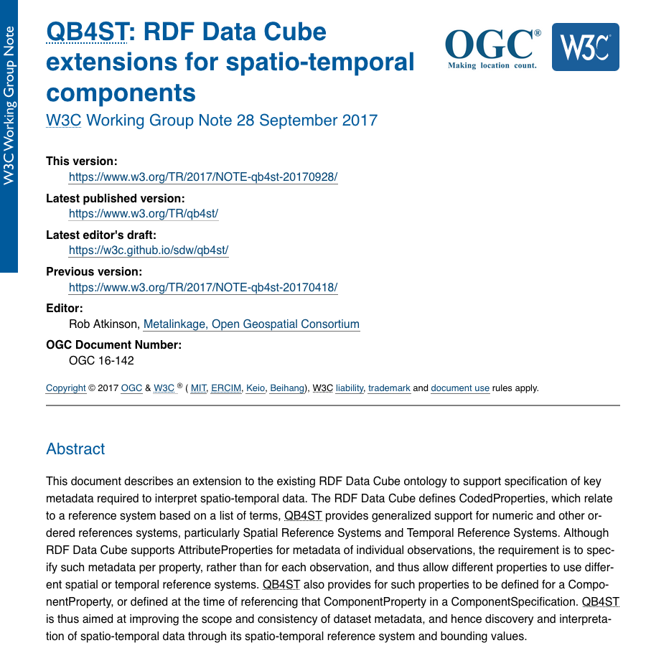
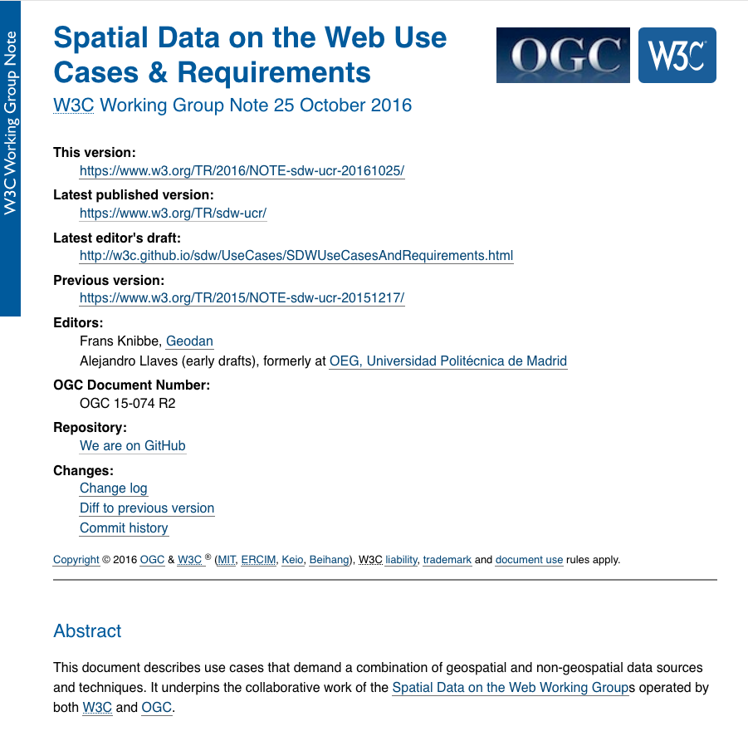
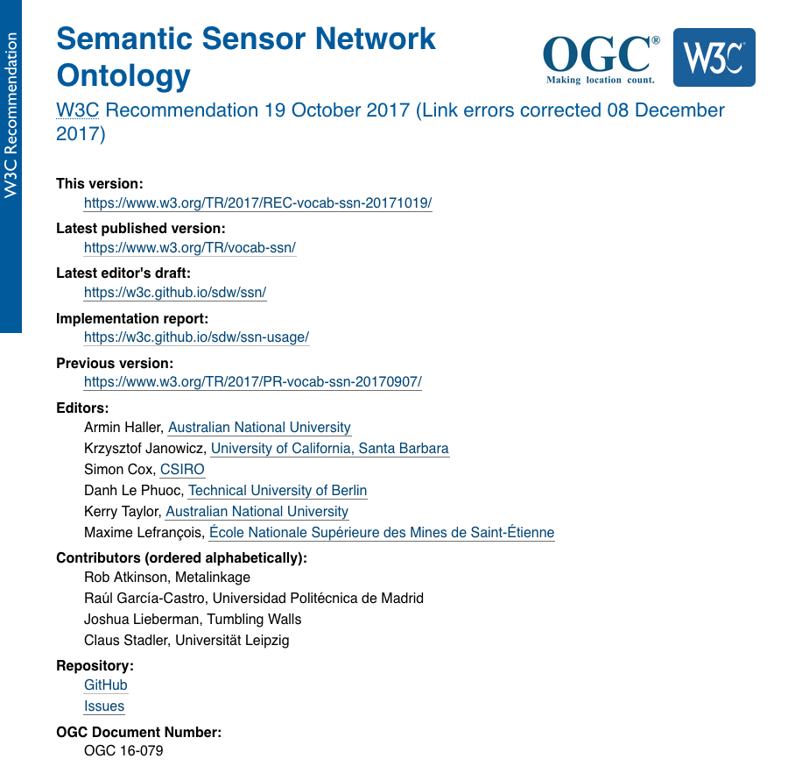
WHAT WAS ACHIEVED?

Slide 9
SPATIAL DATA ON THE WEB BEST PRACTICES
For data publishers and tool developers, aiming at consumption by ordinary Web developers.
Evidence to support best practices for real users, plus identified gaps in practice with advice.

Slide 10
SPATIAL DATA ON THE WEB BEST PRACTICES - LINKABILITY
Sources such as the Best Practices for Publishing Linked Data [LD-BP] assert a strong association between Linked Data and the Resource Description Framework (RDF) [ RDF11-PRIMER]. Yet we believe that Linked Data requires only that the formats used to publish data support Web linking (see [WEBARCH] section 4.4 Hypertext)...
..However, we must make clear to readers that there is no requirement for all publishers of spatial data on the Web to embrace the wider suite of technologies associated with the Semantic Web; we recognize that in many cases, a Web developer has little or no interest in the toolchains associated with Semantic Web due to its addition of complexity to any Webcentric solution.

Slide 11
SPATIAL DATA ON THE WEB BEST PRACTICES - SPATIAL RELATIONS
We identify topological, directional and distance relations.
We propose an update to GeoSPARQL to standardise geometry, geometry versions, coordinate reference systems
GeoSPARQL uses DE-9IM, RCC8 and simple features topological vocabularies
We advise using simple features from GeoSPARQL
Equals — geosparql:sfEquals
Disjoint — geosparql:sfDisjoint
Touches — geosparql:sfTouches
Crosses — geosparql:sfCrosses
Within — geosparql:sfWithin
Contains — geosparql:sfContains
Intersects — geosparql:sfIntersects
Overlaps — geosparql:sfOverlaps
We advise asserting such predicates where useful.

Slide 12
SPATIAL DATA ON THE WEB BEST PRACTICES – GEOMETRY
Use owl:sameAs (carefully), geonames:nearby or foaf:based_near
Or schema:sameAs or bbc:sameAs
But place is a social construct that may be imprecise and opinionated: The Sahara, Renaissance Italy…
We propose samePlaceAs
Is ancient Byzantium the same place as modern Istanbul? What about the nightclub that moved across the street to avoid demolition?
Propose schema:samePlaceAs but ongoing…

Slide 13
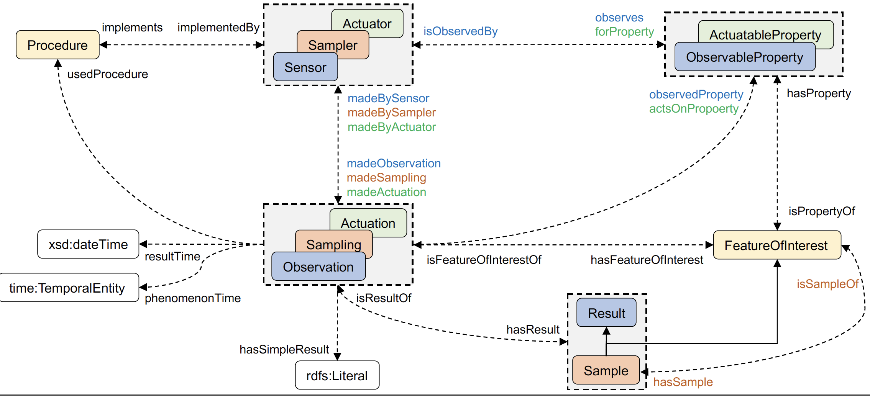
SEMANTIC SENSOR NETWORKS (SSN) ONTOLOGY
Modelling sensors, actuators, samplers, data, systems, and physical objects being observed/sampled/actuated on.

Slide 14
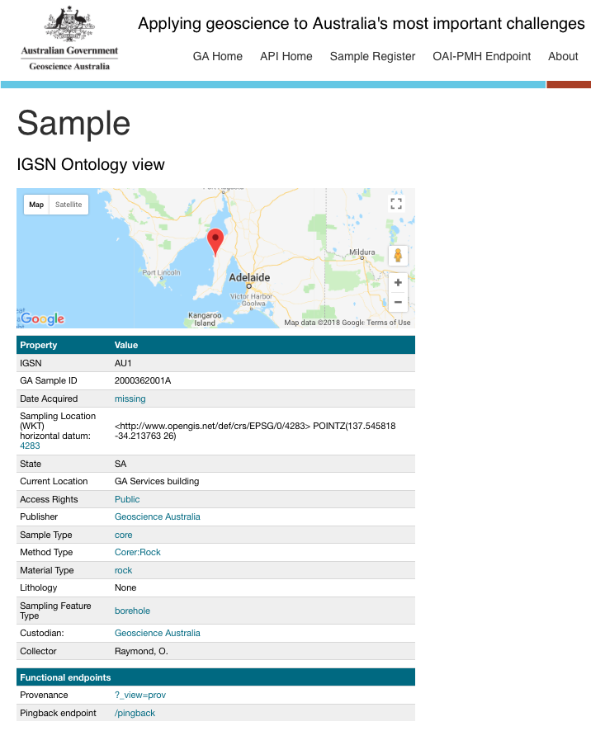
PHYSICAL SAMPLE LOD REPOSITORY
Geoscience Australia's web API delivering metadata for physical samples stored in it's repositories.
Multiple 'views' and 'formats' of samples' metadata is available, including Dublin Core and W3C’s SOSA ontology
http://pid.geoscience.gov.au/sample/

Slide 15
AUSTRALIAN GOVERNMENT LINKED DATA WORKING GROUP
Community of Commonwealth Government experts and champions, with invited non-voting participation of individuals, corporations and other entities.
Established in August 2012, with strong growth in membership since the Government released the outcomes of an inquiry on Data Availability and Use in the Australian Government.
No official Government mandate or related legislation, but a community of practice that promotes and represents a series of federal Government entities who seek to implement and use Linked Data technologies for the betterment of Australian Government data sharing.
Several members have signed an MoU to support the use and persistence of linked.data.gov.au URIs.

Slide 16
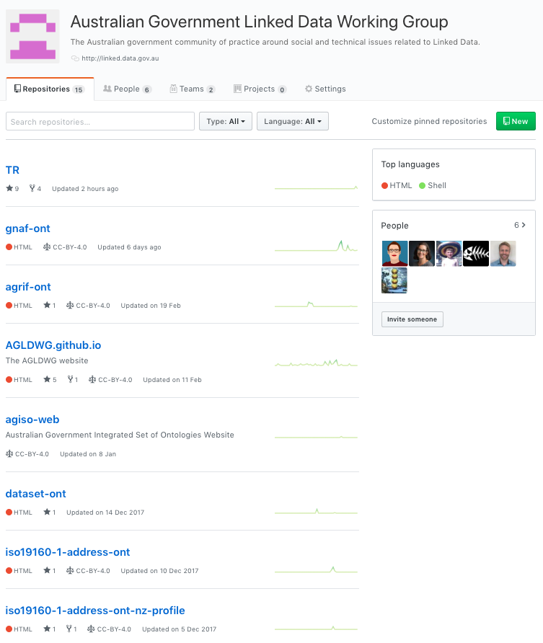
WEB PRESENCE
http://linked.data.gov.au/
https://github.com/AGLDWG

Slide 17
TERMS OF REFERENCE
Establish technical guidance publishing public sector information using Linked Data as a delivery technology
Determine governance rules and processes for the effective management of Australian Government Linked Data
Promote Linked Data across the Australian Government
Engender the development of Linked Data infrastructure

Slide 18
URI GUIDELINES
Top level reserved domain http://{subdomain}.linked.data.gov.au/
{subdomain} includes a set of 25 reserved keywords defined by AGIFT
environment
governance
transport
reference
…

Slide 19
URI GUIDELINES
Set of general guidelines aimed at helping government stakeholders to define and manage URIs for ‘Linked Datasets’ and the resources described within.
Overarching principles:
Use HTTP URIs so that the Linked Dataset URI can be resolved; and
provide at least one machine-readable representation in RDF.
General guidelines on:
Minimum features of a Linked Dataset;
Domain structure of a Linked Dataset;
Recommended URI patterns;
Recommended Publication infrastructure for Linked Datasets;
and URI naming conventions.
https://github.com/AGLDWG/TR/blob/master/guidelines/latest.md

Slide 20
AUSTRALIAN GOVERNMENT INTEGRATED SET OF ONTOLOGIES (AGISO)
Working Group is in the process of developing a proposal for an integrated set of ontologies
Currently, there are several ontologies (e.g. Dataset ontology, AGRIF) being developed with a ‘whole of government’ focus
AGISO aims to integrate these ontologies allowing them to be used individually or collectively in a seamless way: as if they were one data model
In making this proposal, the AGLDWG steps beyond international precedent regarding government Linked Data initiatives, in that we intend to provide semantic modelling resources and governance, not just guidelines and recommendations for Linked Data publication

Slide 21
DATASET ONTOLOGY
Designed to describe the characteristics of datasets published on http://data.gov.au/
Contains elements to describe datasets such as:
Publication
Update
Origin
Governance
Spatial and temporal coverage
Aspects of Organisational Custodianship
Governance arrangements

Slide 22
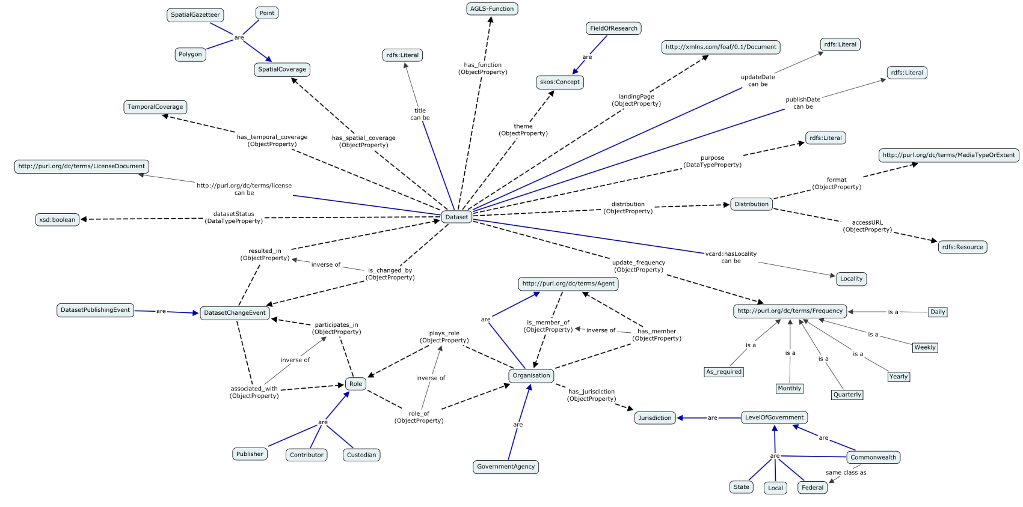
DATASET ONTOLOGY
http://reference.data.gov.au/def/ont/dataset

Slide 23
AUSTRALIAN GOVERNMENT RECORDS INTEROPERABILITY FRAMEWORK (AGRIF)
Ontology to describe the structure, functions, and activities of the Australian Government, providing sufficient context for the effective use of Government information assets.
Contains elements to describe records such as:
Record
Artefact
Event
Policy
Coverage
Role
Agent

Slide 24
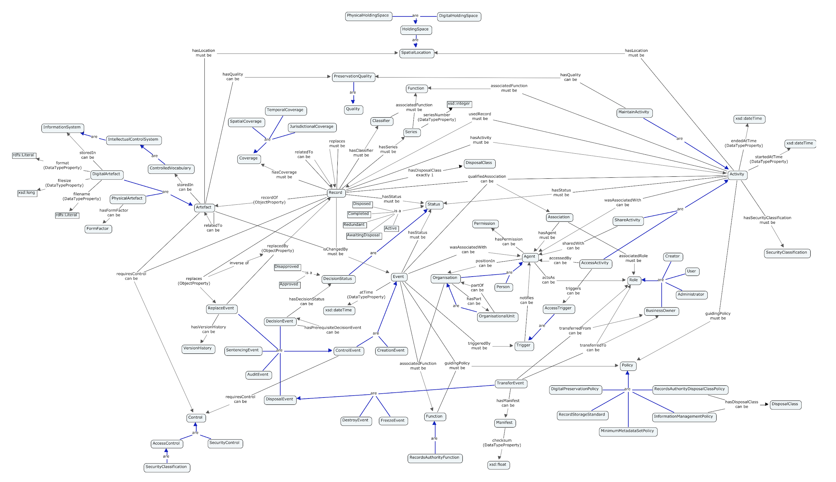
AUSTRALIAN GOVERNMENT RECORDS INTEROPERABILITY FRAMEWORK (AGRIF)
http://pid.data.gov.au/websrv/reference/def/ont/agrif/

Slide 25
QUESTIONS?
http://w3c.org.au
http://linked.data.gov.au
https://github.com/AGLDWG

