Slide 1
Metadata and Linked Data. Where is it all going?
By Nicholas Car for the ANZ MDWG, 2018-06-13
LAND & WATER
Supported by:

Slide 2
About me!
Nicholas Car
Senior Experimental Scientist
Environmental Informatics Group
CSIRO Land & Water
Brisbane
Interested in the totality of Australia’s information
Formerly at GA
Now working across agencies, as best I can
Co-chair of the Aust. Gov. Linked Data WG – linked.data.gov.au
with Armin here!

Slide 3
Outline
Profile upgrade opportunities
Emergent graph

Slide 4
Outline
Profile upgrade opportunities
Emergent graph

Slide 5
Profile upgrade opportunities
Tighten up parts of the standard for particular purposes
Implement things for an entire community – ANZ
Cater for an “emergent graph”

Slide 6
Profile upgrade opportunities
Tighten up parts of the standard for particular purposes
Irina will walk you through GA’s requirements

Slide 7
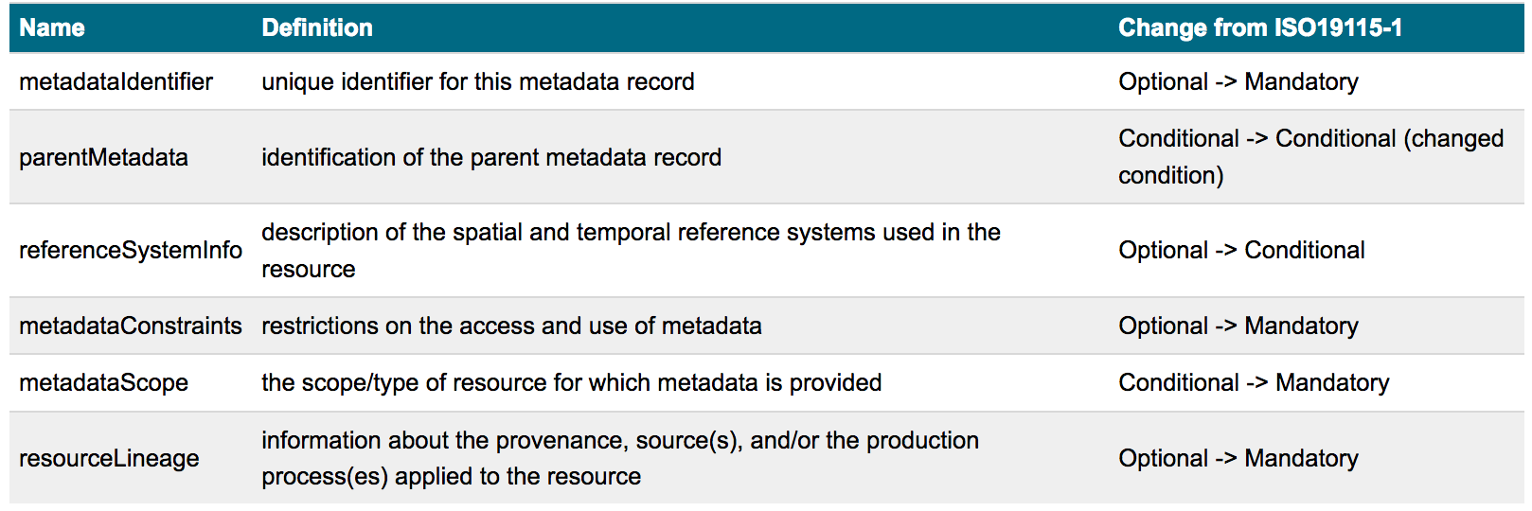
Profile upgrade opportunities
Tighten up parts of the standard for particular purposes
Irina will walk you through GA’s requirements
e.g. Metadata entity set information (MD_Metadata): http://pid.geoscience.gov.au/def/schema/ga/ISO19115-1-2014

Slide 8
Profile upgrade opportunities
Tighten up parts of the standard for particular purposes
Implement things for an entire community – ANZ

Slide 9
Profile upgrade opportunities
Tighten up parts of the standard for particular purposes
Implement things for an entire community – ANZ
Shared expectations
Certain fields are expected from all participants

Slide 10
Profile upgrade opportunities
Tighten up parts of the standard for particular purposes
Implement things for an entire community – ANZ
Shared expectations
Shared codelists
Our community can use a Profile to indicate particular codelists that we nominate for community use.
Particular keywords
Particular catalogue item types
Particular roles
Particular agencies
http://pid.geoscience.gov.au/def/ schema/ga/ISO19115-1-2014

Slide 11
Profile upgrade opportunities
Tighten up parts of the standard for particular purposes
Implement things for an entire community - ANZ
Cater for an “emergent graph”
I will explain…

Slide 12
Outline
Profile upgrade opportunities
Emergent graph

Slide 13
Emergent graph
Tighten up parts of the standard for particular purposes
Implement things for an entire community - ANZ
Cater for an “emergent graph”
We are used to this:
indexation
Metadata documents
Metadata DB

Slide 14
Emergent graph
Tighten up parts of the standard for particular purposes
Implement things for an entire community - ANZ
Cater for an “emergent graph”
And to some extent this:
harvesting
indexation
Metadata documents
Metadata DB

Slide 15
Emergent graph
Tighten up parts of the standard for particular purposes
Implement things for an entire community - ANZ
Cater for an “emergent graph”
We want this:
?
Metadata documents
Information graph

Slide 16
Emergent graph
An information graph:
* better represents the way we understand information
* If done using Linked Data, can Join information at any granularity and across many systems
Tighten up parts of the standard for particular purposes
Implement things for an entire community - ANZ
Cater for an “emergent graph”
We want this:
?
Metadata documents
Information graph

Slide 17
Emergent graph
An information graph:
* why?
* The total information we want is stored in many, different systems
Tighten up parts of the standard for particular purposes
Implement things for an entire community - ANZ
Cater for an “emergent graph”
We want this:
?
Metadata documents
Information graph

Slide 18
Emergent graph
Tighten up parts of the standard for particular purposes
Implement things for an entire community - ANZ
Cater for an “emergent graph”
Actually this:
Metadata documents

Slide 19
Emergent graph
Tighten up parts of the standard for particular purposes
Implement things for an entire community - ANZ
Cater for an “emergent graph”
Actually this:
how ?
Metadata documents

Slide 20
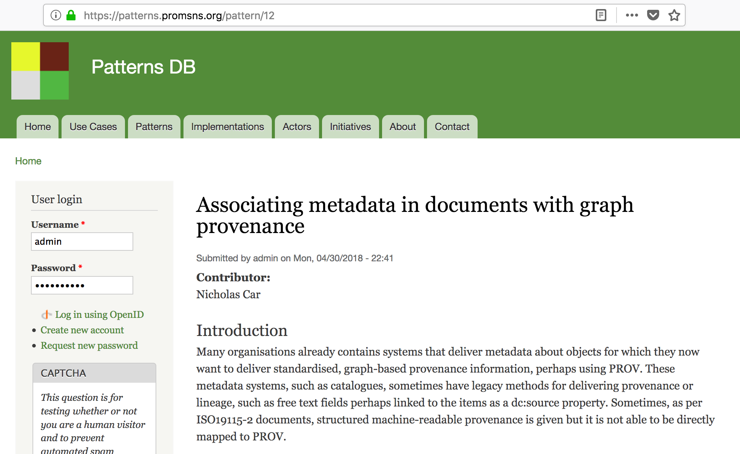
Emergent graph - pattern
Research Data Alliance

Slide 21
Emergent graph – how, at GA
(but first why: information in multiple places/systems)

Slide 22
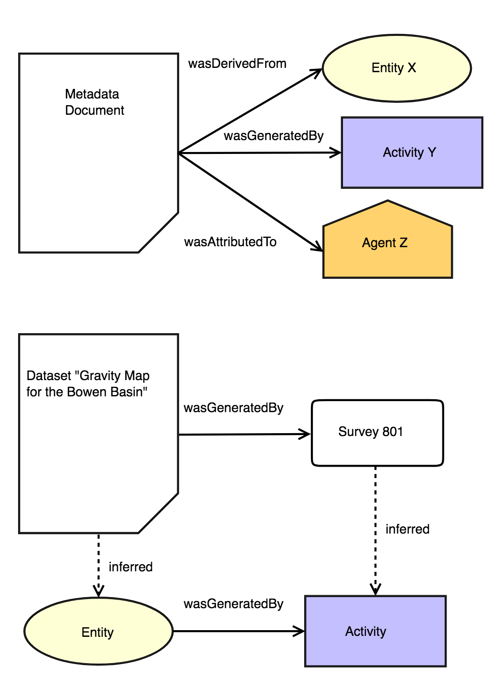
Pattern 12.2
As implemented in test at GA

Slide 23
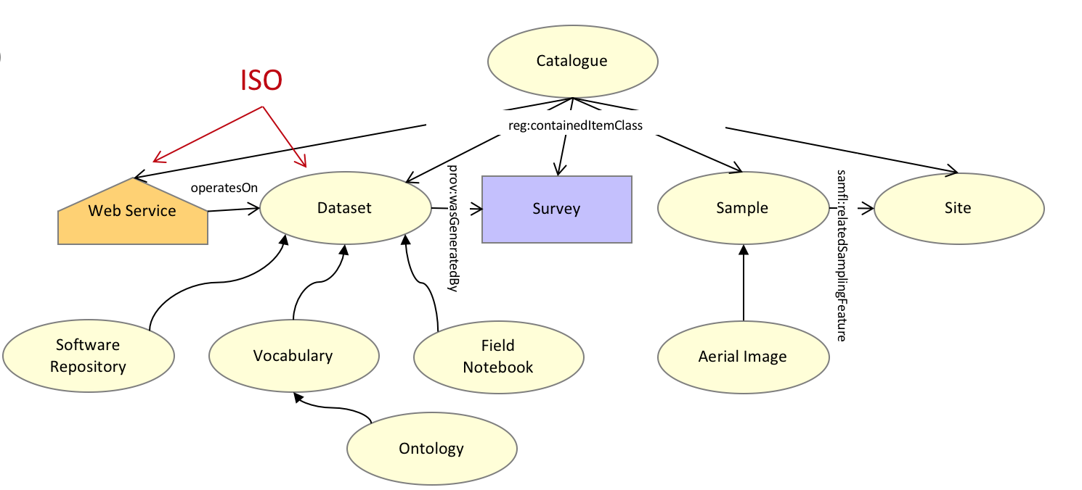
Emergent graph – how, at GA
http://pid.geoscience.gov.au/def/ont/ga/pdm
GA’s top-level data model relates items within IS19115-1 catalogues and others

Slide 24
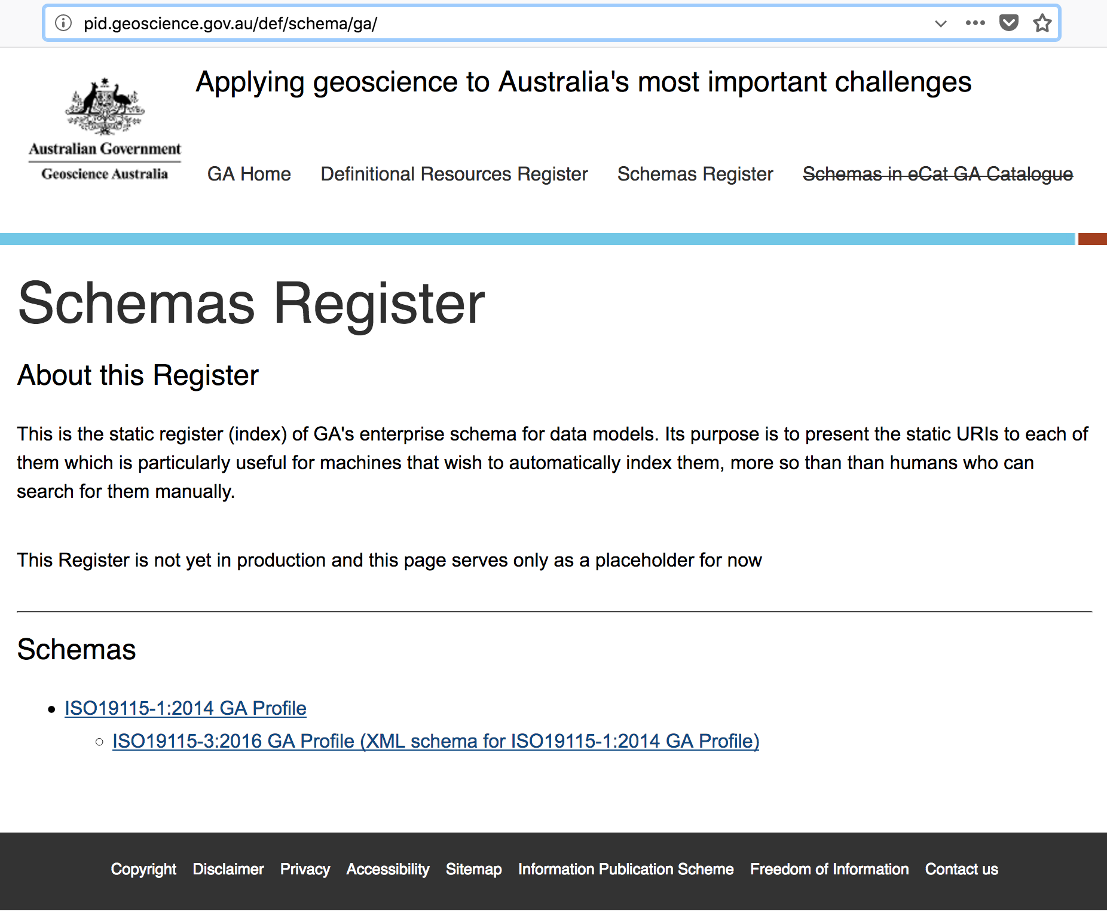

Slide 25
Emergent graph – how, at GA
http://pid.geoscience.gov.au/def/schema/ga/ISO19115-3-2016/codelist/assocTypeCode_codelist.html

Slide 26
Emergent graph – how, at GA
Dataset 82033 was derived from Dataset 70908 - wasDerivedFrom
<cit:CI_Citation>
…
</cit:CI_Citation>
<mri:associationType>
<mri:DS_AssociationTypeCode codeList="codeListLocation# DS_AssociationTypeCode" codeListValue="wasDerivedFrom" />
</mri:associationType>
<mri:associatedResource>
<mri:MD_AssociatedResource>
….
</mri:MD_AssociatedResource>
</mri:associatedResource>
<cit:CI_OnlineResource>
<cit:linkage>
<gco:CharacterString>
http://pid.geoscience.gov.au/dataset/ga/70908
</gco:CharacterString>
</cit:linkage>
…

Slide 27
Emergent graph – FSDF
http://pid.geoscience.gov.au/def/ont/ga/link

Slide 28
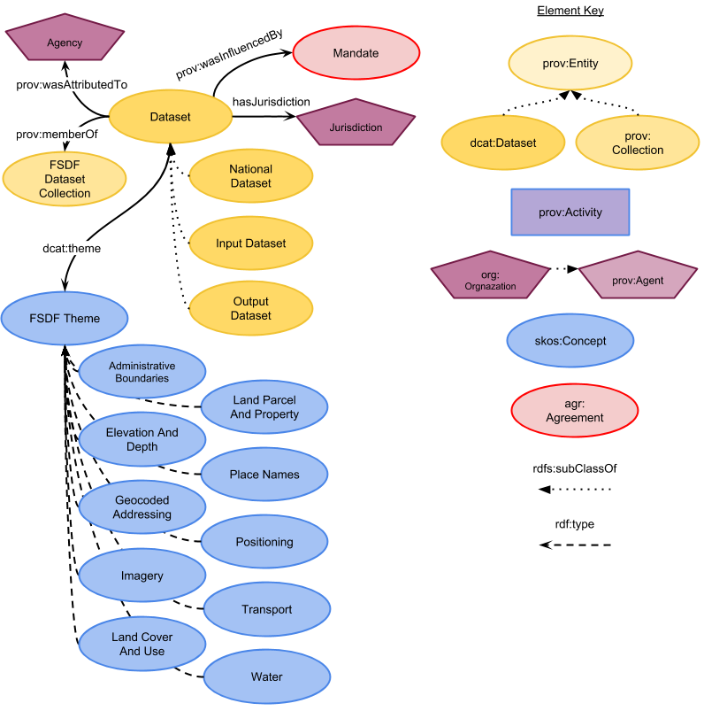
Emergent graph – FSDF

Slide 29
Emergent graph – FSDF
An Org
National Dataset
FSDF Product

Slide 30
Emergent graph – FSDF
An Org
wasDerivedFrom
National Dataset
FSDF Product

Slide 31
Emergent graph – FSDF
Input Dataset X
used
wasGeneratedBy
wasDerivedFrom
Input Dataset Y
FSDF Activity
National Dataset
FSDF Product
Input Dataset Z

Slide 32
Emergent graph – FSDF
Other Org
An Org
Other, Other Org
Input Dataset X
used
wasGeneratedBy
wasDerivedFrom
Input Dataset Y
FSDF Activity
National Dataset
FSDF Product
Input Dataset Z

Slide 33
Emergent graph – FSDF
Input Dataset X
Input Dataset Y
FSDF Activity
National Dataset
FSDF Product
Input Dataset Z
Certainty of continuation?

Slide 34
Emergent graph – FSDF
Input Dataset X
X
Input Dataset Y
FSDF Activity
National Dataset
FSDF Product
Input Dataset Z
Mandate 1
Mandate 2
Mandate 3

Slide 35
Emergent graph – Linked Data
Use URIs to identify everything
Datasets, Orgs, Mandates
Elements within datasets

Slide 36
Emergent graph – Linked Data
Use URIs to identify everything
Datasets, Orgs, Mandates
Elements within datasets
Use the Internet to hop across systems / orgs
Items in one catalog link to items in another via URIs

Slide 37
Emergent graph – Linked Data
Use URIs to identify everything
Datasets, Orgs, Mandates
Elements within datasets
Use the Internet to hop across systems / orgs
Items in one catalog link to items in another via URIs
Use LD mechanics to get different views of things
Purse ISO19115-1
ANZLIC Profile
Profile X
PROV

Slide 38
Go forth and interoperate!
Nicholas Car Environmental Informatics Land & Water, Brisbane nicholas.car@csiro.au
LAND & WATER

Slide 39
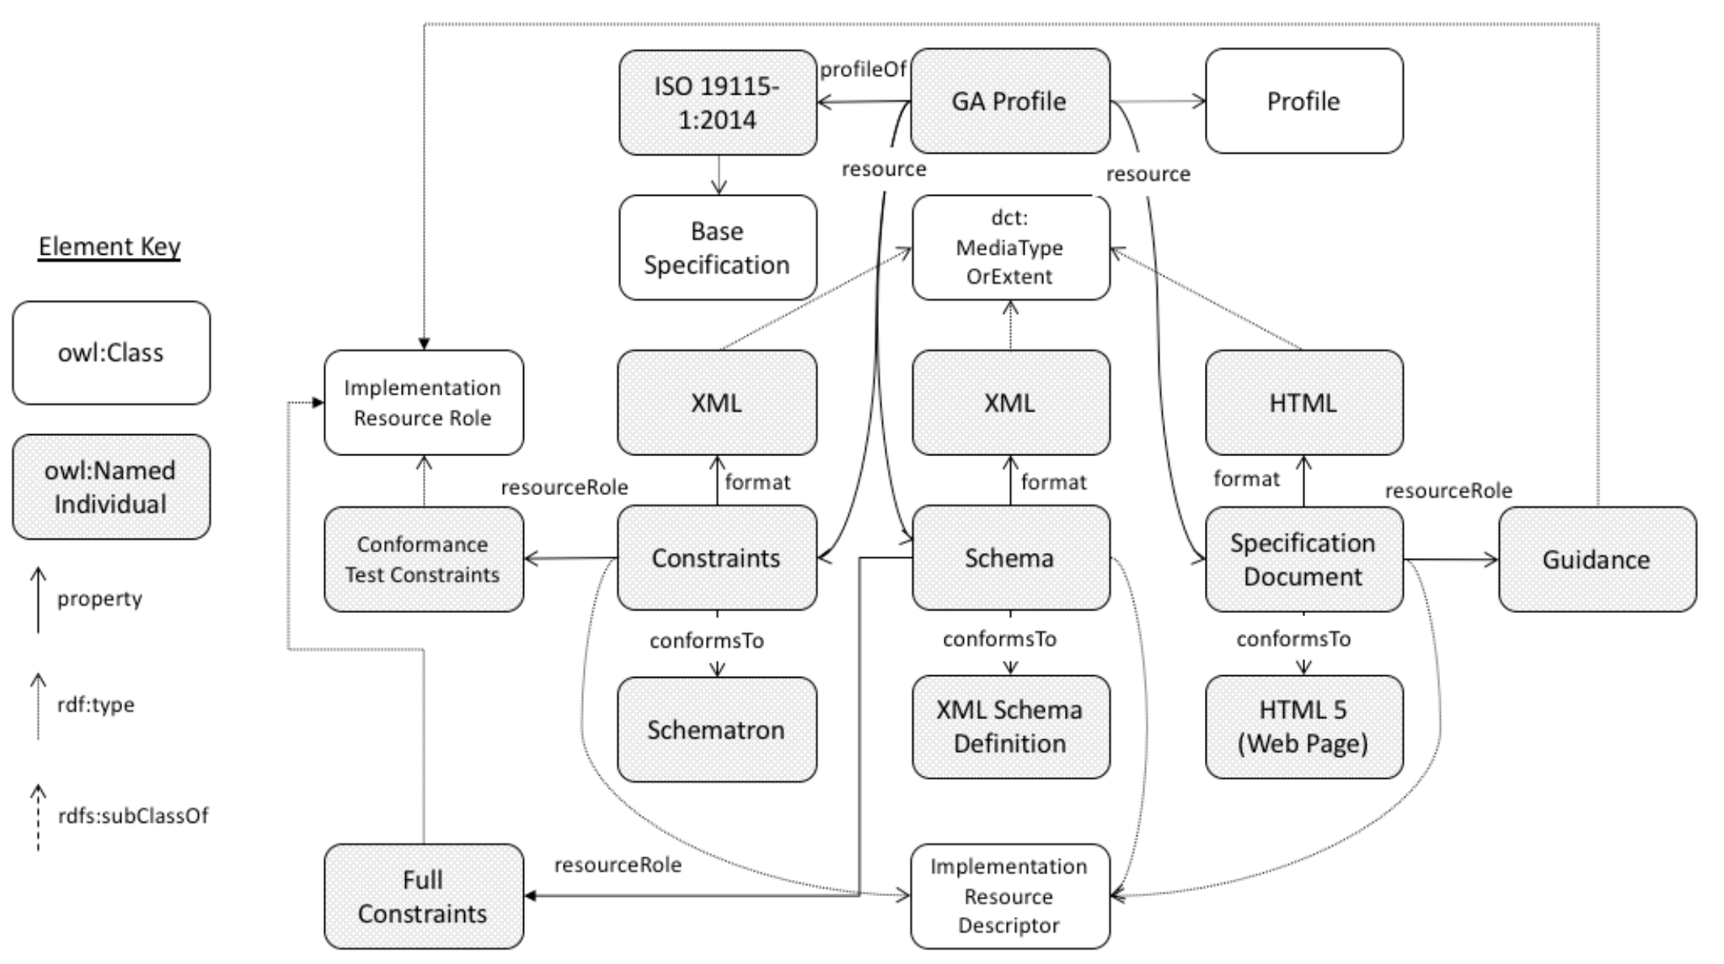

Slide 40
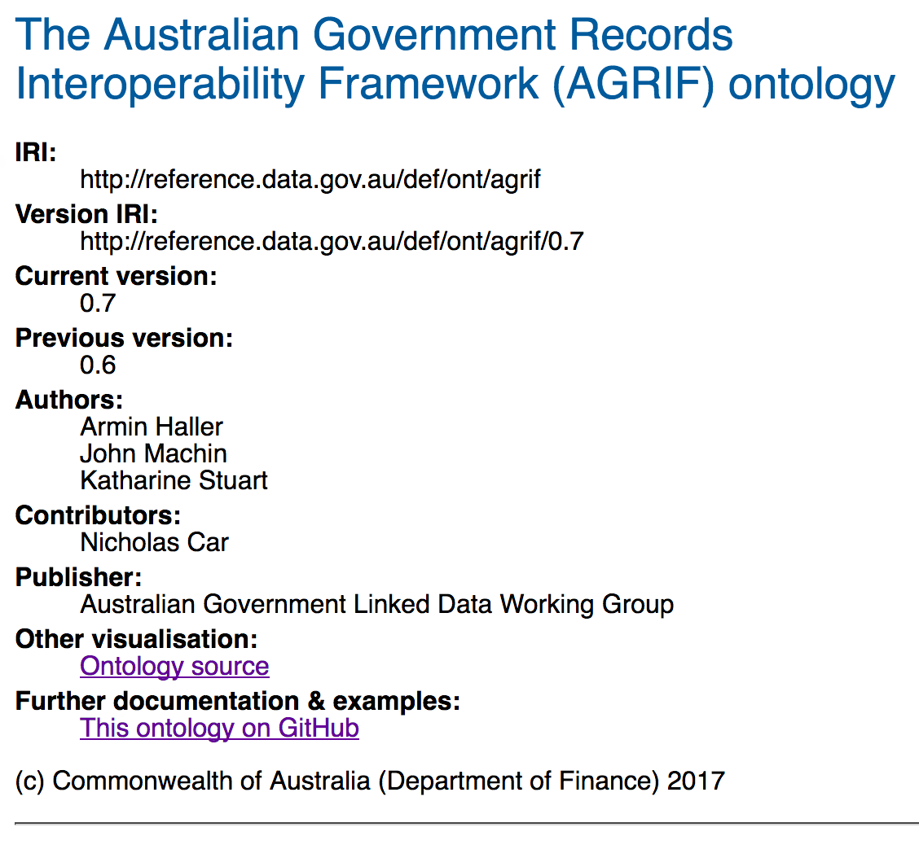

Slide 41
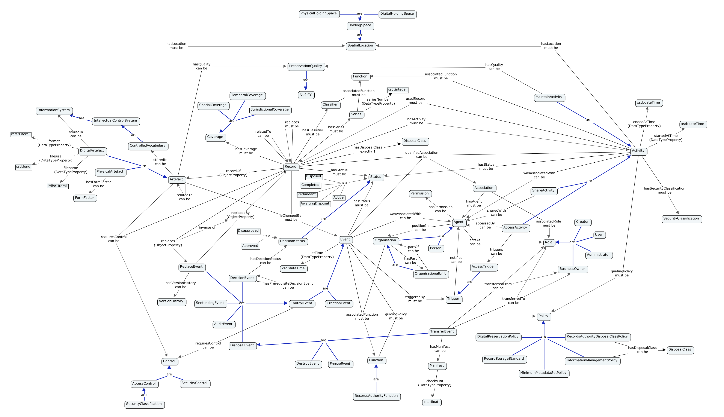

Slide 43
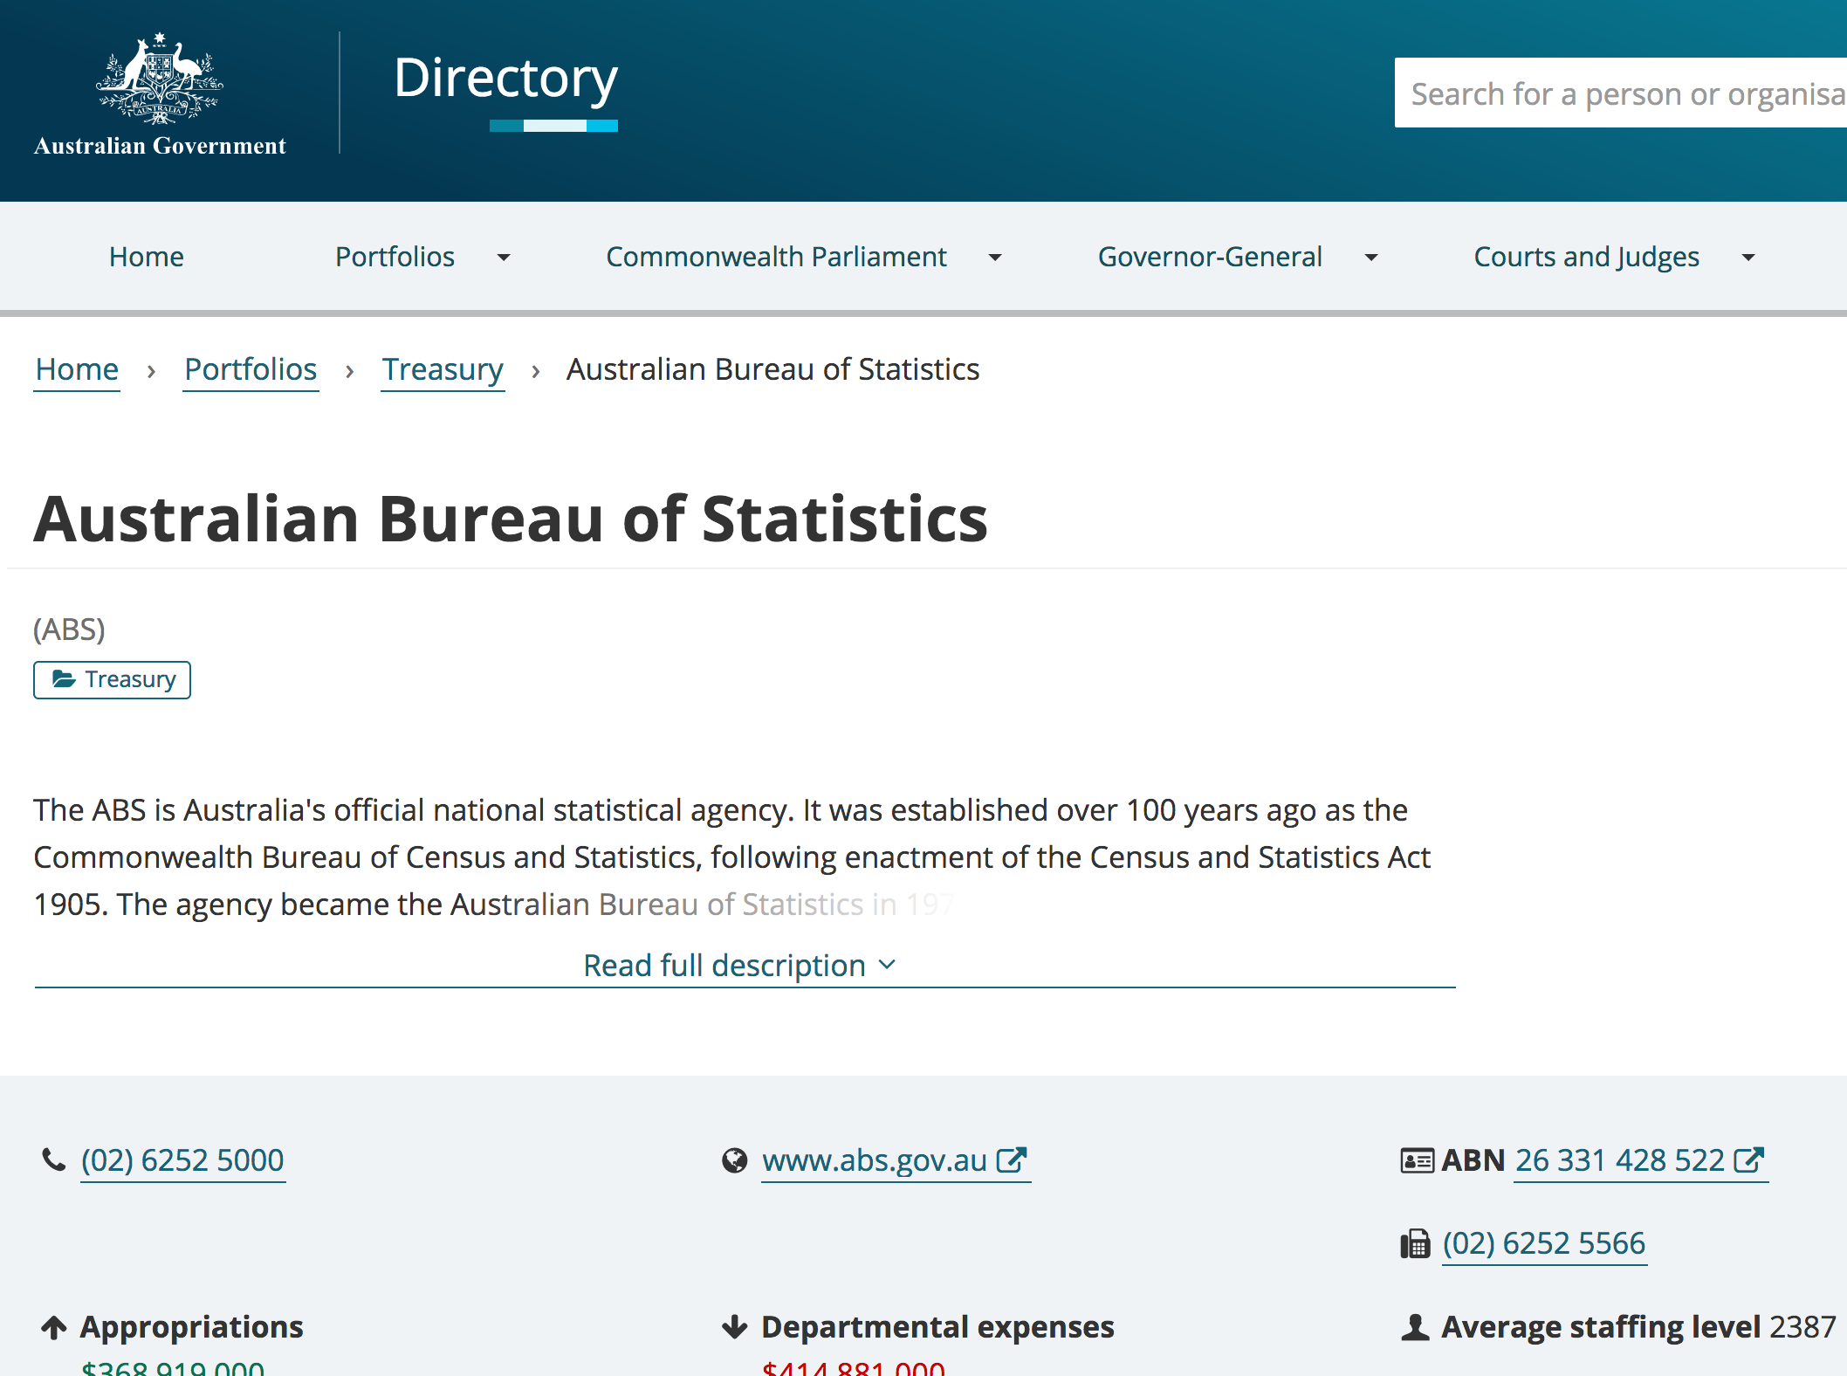

Slide 44
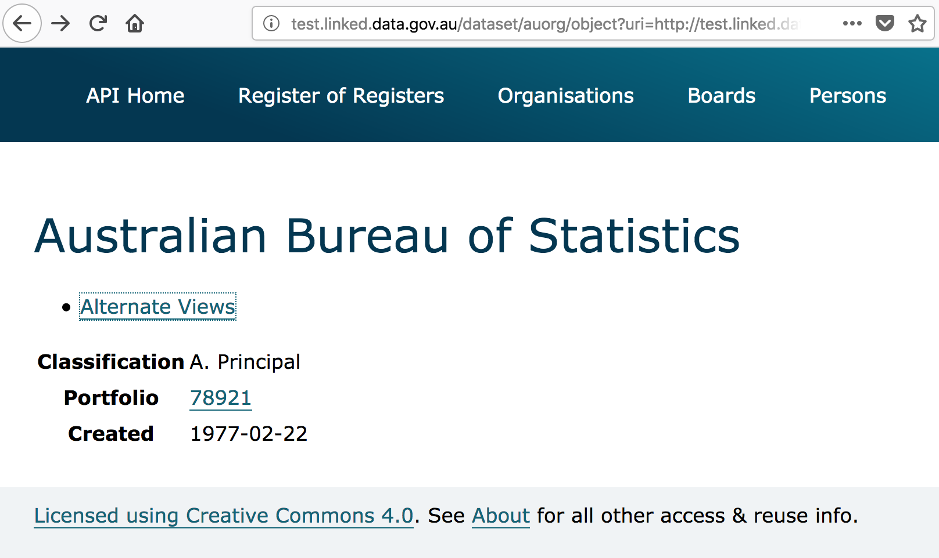

Slide 45
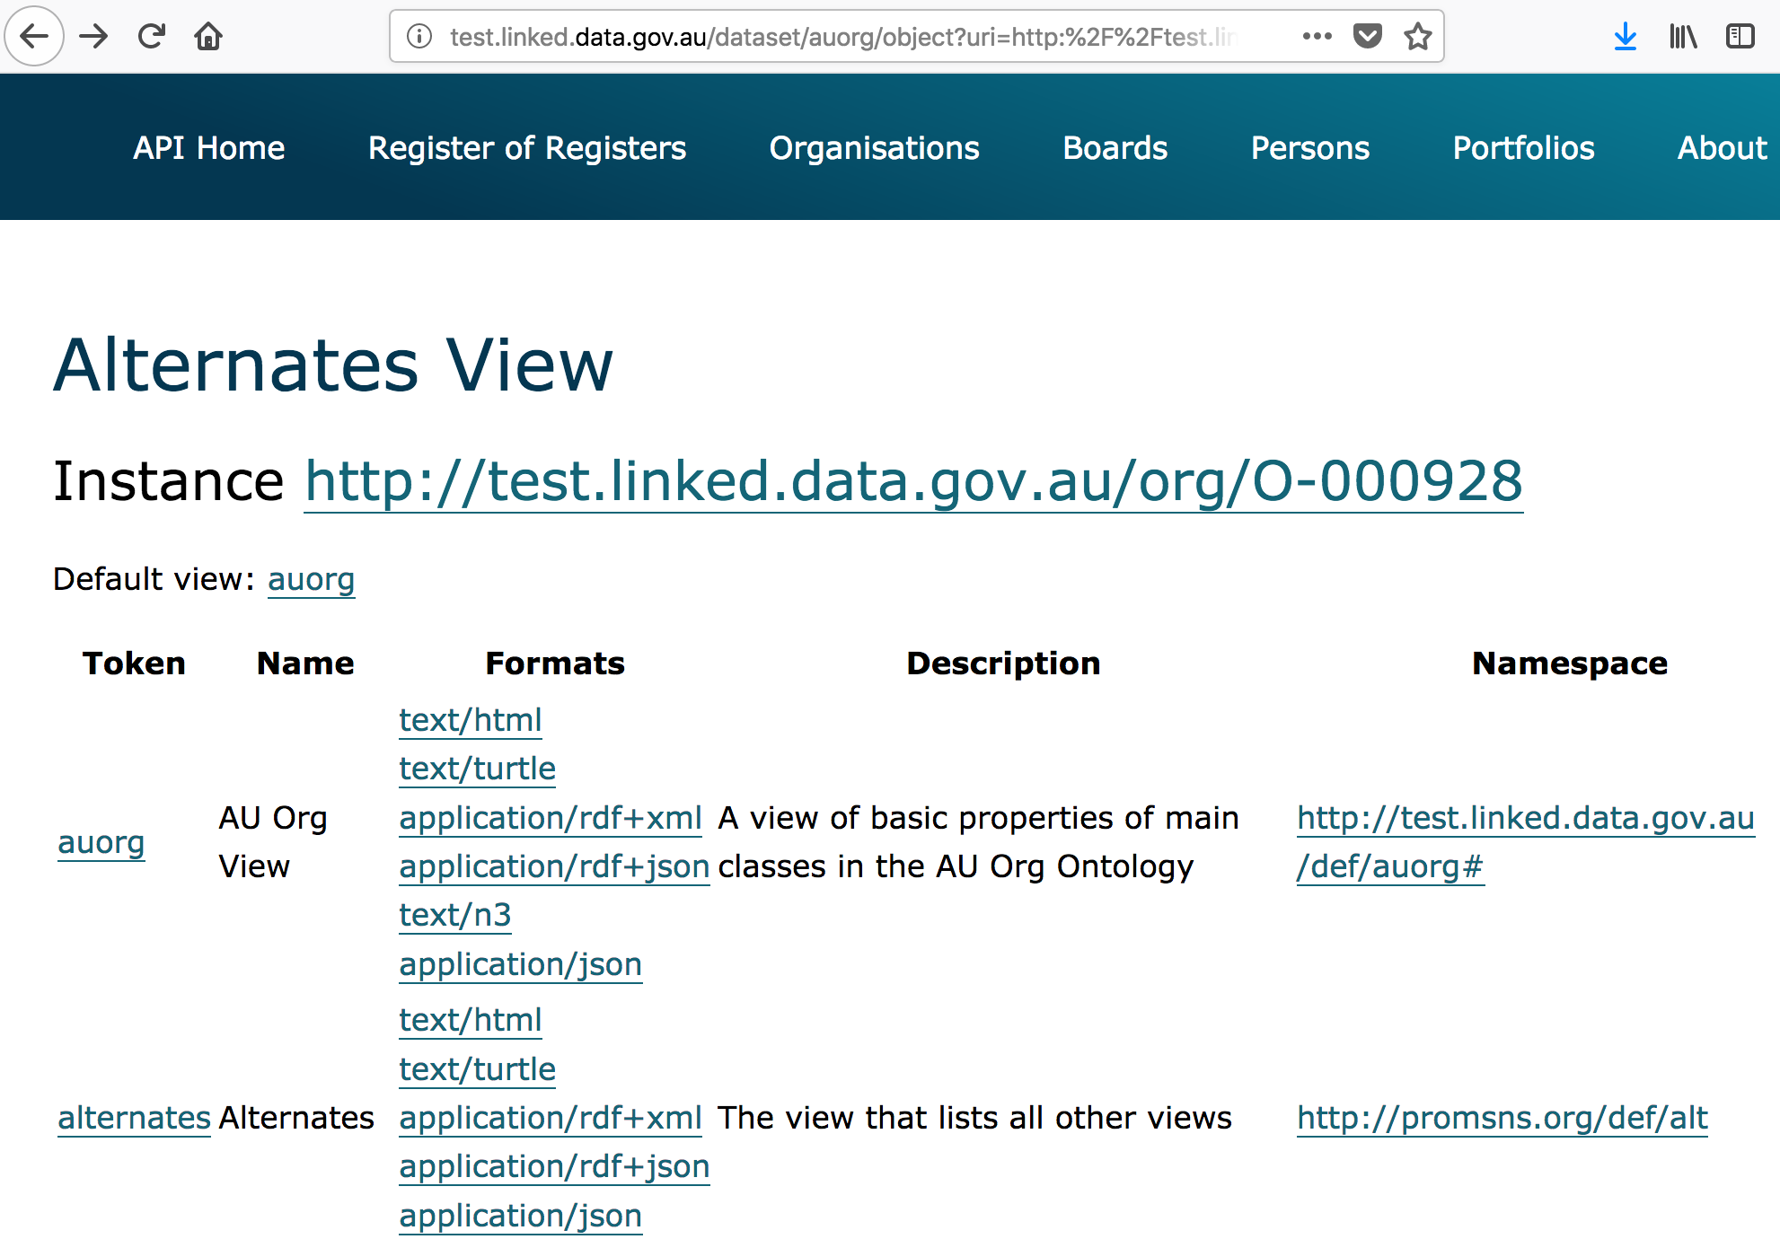

Slide 46
<http://test.linked.data.gov.au/org/O-000928> a auorg#NonCorporateCommonwealthEntity , org:Organization ;
rdfs:label "Australian Bureau of Statistics" ;
…
auorg:budgetAppropriations "368919000"^^auorg:AustralianDollars ;
auorg:portfolio <http://test.linked.data.gov.au/portfolio/78921> ;
…
owl:seeAlso <http://www.abs.gov.au> ;
vcard:hasStreetAddress <http://gnafld.net/address/GAACT714857871> ;
…

Slide 47
