Slide 1
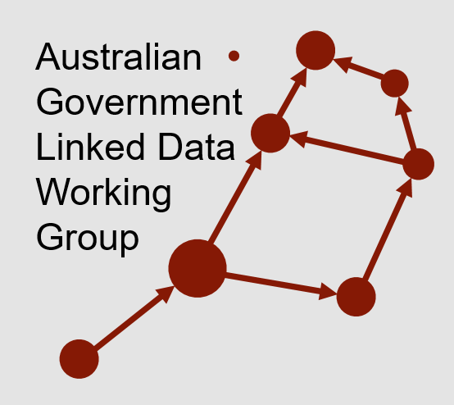

The Australian Case Study:
Governance of Federal Data
Nicholas Car
Co-Chair AGLDWG, Senior Experimental Scientist, CSIRO

Slide 2
The Australian Case Study:
Governance of Federal Data
˅
Federated
Nicholas Car
Co-Chair AGLDWG, Senior Experimental Scientist, CSIRO

Slide 3
About me – Nicholas Car
Currently a computer scientist based at CSIRO, Australia’s national scientific research agency
Currently co-chair of an informal govt. group involved with data sharing, the Australian Government Linked Data WG
Formerly Data Architect of Geosceince Australia – national geo science agency and a large data publisher
Working on national data sharing systems and fundamental government datasets

Slide 4














Australian Government Linked Data WG
Aust. Gov. experts and champions for Linked Data
Informal body, formal participation of members
Established 2012
Recent membership growth due to govt. policy interest
Operates with an MoU between agencies

Slide 5
Outline
Australian data landscape
Distributed data production
  Producing data independently with individual authority
Interoperability
  Allowing data to interoperate with other independently-produced government data
Data harmonisation & integrity
  Reducing the effort required for data harmonising for use while still maintaining data integrity
Summary of aims for industry

Slide 6

Australian data landscape
National Innovation & Science Agenda (2015) - $1.1B f
  backing entrepreneurs’ use of public research
  increasing industry/research collaboration
  developing and attracting world-class talent
  Australian Government leading by example; embracing innovation and agility in business
  https://www.industry.gov.au/strategies-for-the-future/boosting-innovation-and-science

Slide 7
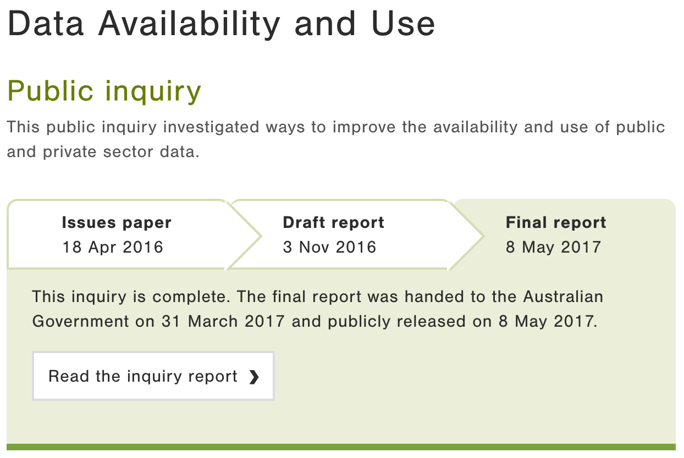
Australian data landscape
Data Availability & Use (2017)
  benefits & costs of making Gov. data more available
  options for collection, sharing and release of data
  identified ways consumers could use & benefit from
  access to data, particularly data about themselves
  considered individual
  privacy & control over
  data
https://www.pc.gov.au/inquiries/
completed/data-access#report

Slide 8

Australian data landscape
Digital Transformation Agency (2017)
  “We exist to make it easy for people to deal with government. We help government transform services to be simple, clear and fast.”
https://www.dta.gov.au

Slide 9

Australian data landscape
National Data Commissioner (2018)
  “implementing a simpler data sharing and
  release framework”
  https://www.datacommissioner.gov.au

Slide 10
Outline
Australian data landscape
Distributed data production
  Producing data independently with individual authority
Interoperability
  Allowing data to interoperate with other independently-produced government data
Data harmonisation & integrity
  Reducing the effort required for data harmonising for use while still maintaining data integrity
Summary of aims for industry

Slide 11
Distributed data production
Producing data independently with individual authority
Why this is necessary?
Current work
Case study

Slide 12
Distributed data production
Why this is necessary?
  Agencies can’t work together – jurisdictional & technical reasons
  Even if willing, noone knows all data initiatives
  Agencies will not, and should not, cede authority to others
    Authority carries trust
  Huge efforts made to ensure data in hand is authoritative
    Direct publication makes this easier

Slide 13

Distributed data production
Current work
  National Data Commissioner, Accredited Data Authorities
    “hubs of expertise to enable other datasets of public interest to be linked, shared or released”
  National Interest Datasets – example, G-NAF
  Demonstrator projects
    MADIP & Blade
    ‘Spines’

Slide 14
Distributed data production
Case study – LOC-I
  One of the ‘spines’

Slide 15
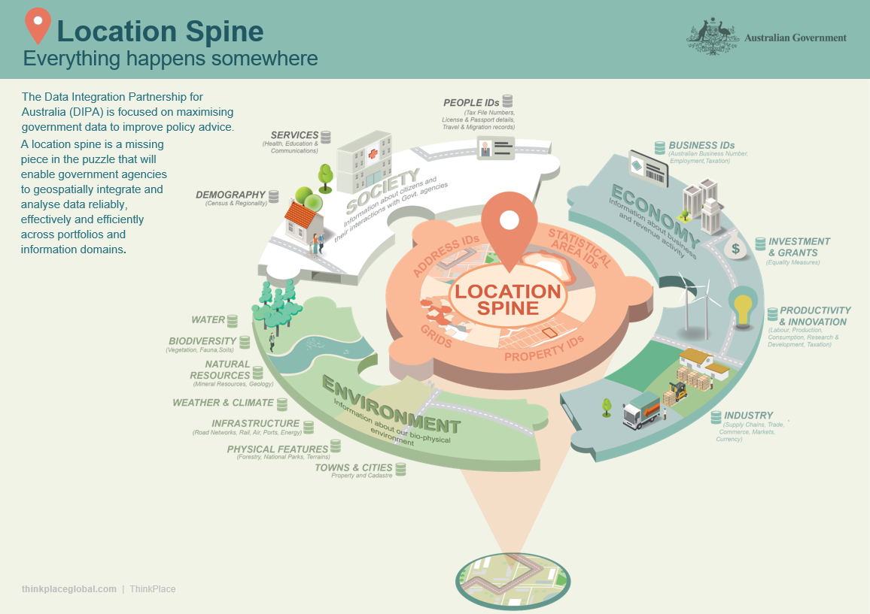
https://confluence.csiro.au/display/DIPAAnalyticHubs/Project+Overview

Slide 16
Distributed data production
Case study – LOC-I
  Distributed generation & publication of national spatial datasets, different agencies
    Geocoded addresses - buyout
    Digital elevation model & water - previous work
    Statistical geographies - current work
  Integration – current work
    Interoperability - technical, next
    Access - mostly public, doesn’t have to be

Slide 17
Outline
Australian data landscape
Distributed data production
  Producing data independently with individual authority
Interoperability
  Allowing data to interoperate with other independently-produced government data
Data harmonisation & integrity
  Reducing the effort required for data harmonising for use while still maintaining data integrity
Summary of aims for industry

Slide 18
Interoperability
Allowing data to interoperate with other independently-produced government data

Slide 19
Interoperability
Allowing data to interoperate with other independently-produced government data
  …and indicate how the private sector may too!

Slide 20
Interoperability
Interoperability principles
  Persistent identity
    Managed identifiers for dataset, elements within them and lookup values
    Long-term stable, regardless of tech or org changes
linked.data.gov.au – the dedicated, persistent govt. identifier domain
http://linked.data.gov.au/dataset/gnaf/address/GAACT714845933 - a specific address identifier
http://linked.data.gov.au/def/reg-status/submitted - the term ‘submitted’ within a vocabulary

Slide 21
Interoperability
Interoperability principles
  Persistent Identity
  Formal modelling paradigms
    Model ‘anything’ with a formal semantics
    Create overarching models
    Create detailed, nested models
      LOC-I model & individual dataset models

Slide 22
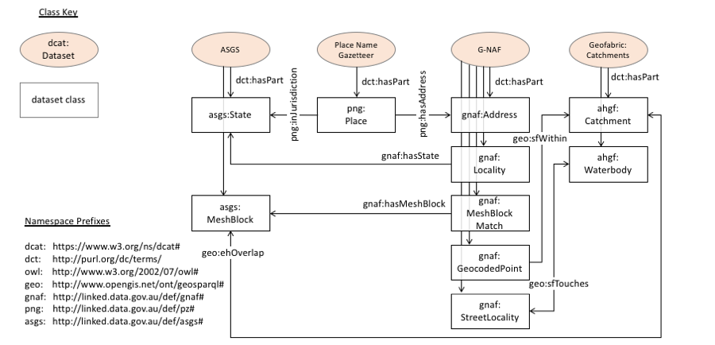
Interoperability
Interoperability principles
  Persistent Identity
  Formal modelling paradigms
    Model ‘anything’ with a formal semantics
    Create overarching models
    Create detailed, nested models
      LOC-I model & individual dataset models

Slide 23
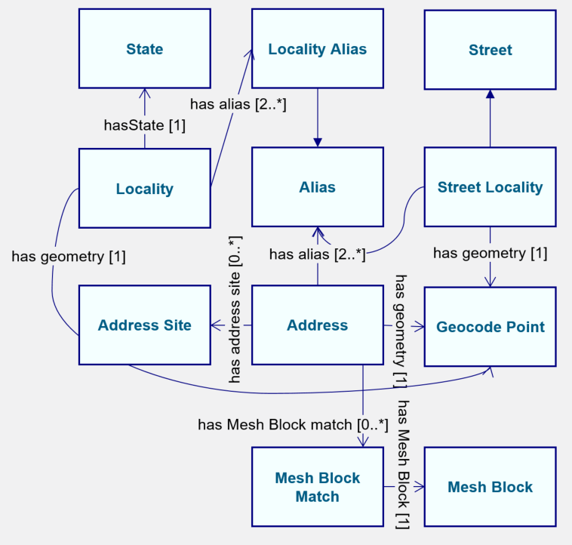
Interoperability
Interoperability principles
  Persistent Identity
  Formal modelling paradigms
    Model ‘anything’ with a formal semantics
    Create overarching models
    Create detailed, nested models
      LOC-I model & individual dataset models
G-NAF

Slide 24
Interoperability
Interoperability principles
  Persistent Identity
  Formal modelling paradigms
  Reference metadata
- Person
- Pensioner
- Student
- Worker
Different dataset, the same terms used

Slide 25
Interoperability
Interoperability principles
  Persistent Identity
  Formal modelling paradigms
  Reference metadata
  Reference data
    LOC-I and other ‘spines’

Slide 26
Interoperability
Interoperability principles
  Persistent Identity
  Formal modelling paradigms
  Reference metadata
  Reference data
  Case study: Longitudinal Spine of Government Functions

Slide 27
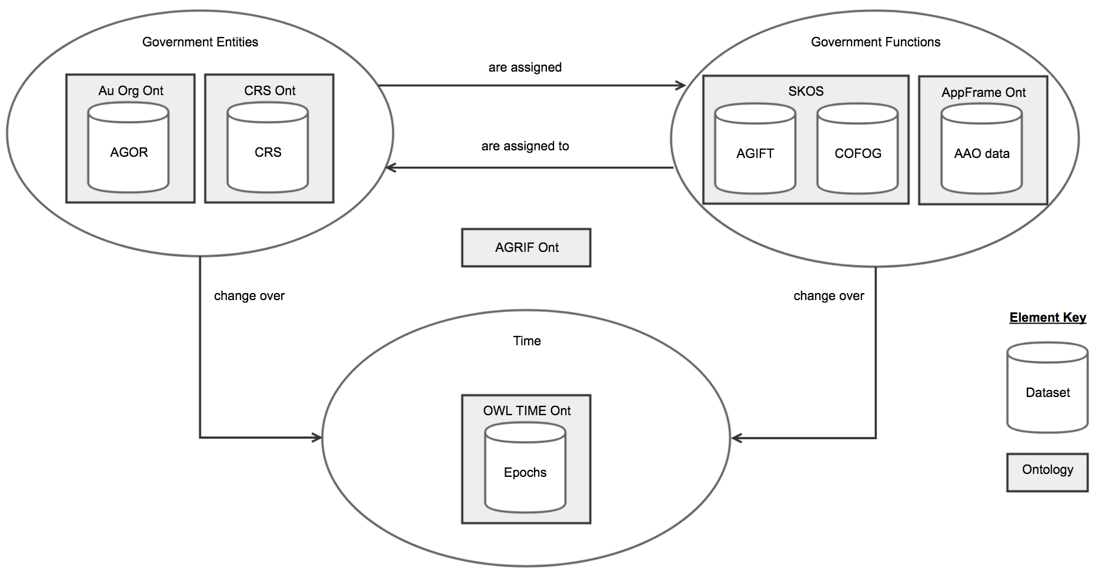
Interoperability
  Case study: Longitudinal Spine of
  Government Functions
Interoperability principles
  Persistent Identity - linked.data.gov.au used
  Formal modelling paradigms - Web Ontology Language
  Reference metadata - Functions vocabularies
  Reference data - Time epochs, govt. orgs.
  Case study: Longitudinal Spine of Government Functions

Slide 28
Interoperability
Interoperability principles
  Persistent Identity - linked.data.gov.au used
  Formal modelling paradigms - Web Ontology Language
  Reference metadata - Functions vocabularies
  Reference data - Time epochs, govt. orgs.
  Case study: Longitudinal Spine of Government Functions

Slide 29
Outline
Australian data landscape
Distributed data production
  Producing data independently with individual authority
Interoperability
  Allowing data to interoperate with other independently-produced government data
Data harmonisation & integrity
  Reducing the effort required for data harmonising for use while still maintaining data integrity
Summary of aims for industry

Slide 30
Data harmonization & integrity
Reducing the effort required for data harmonising for use while still maintaining data integrity
Proportionate phases of data use
Discover
Access
Prepare
Use

Slide 31
Data harmonization & integrity
Harmonization
  Data with persistent identity & formal semantics
    is better than
      Locally identified, semi-structured, ill-defined data
    Is not a huge proportionate impost on large datasets’ production
    Can be a one-time task
  Reference datasets & data
    Is a national responsibility
    Requires coordination & discipline
With harmonisation Preparation is easy…

Slide 32
Data harmonization & integrity
Integrity
  Indicated by
    Nominating Accredited Data Authorities
    Use of national identifiers
  Preserved by
    Allowing distributed publication
    Oversight of publication methods & standards
      National Data Commissioner
      Digital Transformation Agency
      Linked Data WG
    Data quality a matter for individual jurisdictions
  Checked by
    Projects that demonstrate distributed data use
    Data validators*

Slide 33
Aust Govt Integrated Set of Ontologies (AGISO)
CSIRO is developing tools to
Publish models and collections of them for reuse
Validate detailed models’ adherence to overarching models
Validate data’s adherence to models
CSIRO involved in web standards – W3C – and tools for Web Ontology Language content validation

Slide 34
AGISO cont. – LOC-I
First implementation test in LOC-I project
path association
path association ← via spatial & AGISO associations
Govt. Org Data
Business Data
Enviro Data
spatial association
spatial association
spatial association
Geofabric
G-NAF
Adm Bnds
AGISO spatial datasets
AGISO association

Slide 35
Outline
Australian data landscape
Distributed data production
  Producing data independently with individual authority
Interoperability
  Allowing data to interoperate with other independently-produced government data
Data harmonisation & integrity
  Reducing the effort required for data harmonising for use while still maintaining data integrity
Summary of aims for industry

Slide 36
Summary of aims for industry
Government data should be
  Easier to harmonize and thus use
  Trusted due to authority retained
  Indicates how industry could/should operate
  Able to be used in non-open systems

Slide 37
Questions?
Contacts
AGLDWG: http://linked.data.gov.au
Nicholas: nicholas.car@csiro.au

