Slide 1
League of Data
Data Consolidation from Various Sources, Locations and Technologies
NextBigTechAsia, 12th September, 2019
By Nicholas J. Car
Data Systems Architect, SURROUND Australia Pty Ltd
Co-Chair, Australian Government Linked Data Working Group
http://linked.data.gov.au

Slide 2
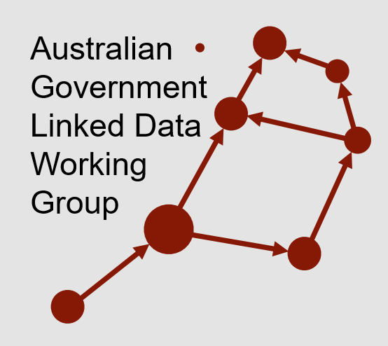
League of Data
Data Consolidation from Various Sources, Locations and Technologies
NextBigTechAsia, 12th September, 2019
By Nicholas J. Car
Data Systems Architect, SURROUND Australia Pty Ltd
Co-Chair, Australian Government Linked Data Working Group
http://linked.data.gov.au
{
my role today

Slide 3
Outline
Situating – this presentation among others today
Backgrounding – Australian government context, my work
Reflecting – on last year’s presentations
Australian Government initiatives
Legal
Governance
Research
Technical
Investment

Slide 4
Outline
Situating – this presentation among others today
Backgrounding – Australian government context, my work
Reflecting – on last year’s presentations
Australian Government initiatives
Legal
Governance
Research
Technical
Investment
}
All relevant for data consolidation

Slide 5
Outline
Situating – this presentation among others today
Backgrounding – Australian government context, my work
Reflecting – on last year’s presentations
Australian Government initiatives
Legal
Governance
Research
Technical
Investment
}
my focus today: League of Data

Slide 6
Outline
Situating – this presentation among others today
Backgrounding – Australian government context, my work
Reflecting – on last year’s presentations
Australian Government initiatives
Legal
Governance
Research
Technical
Investment
}
my current company’s interest, shhh!

Slide 7
Situating
Conference context:
“With the emergence of AI, the competitive landscape has become highly disruptive, forcing companies to analyse new market trends, improve operational efficiency, and find appropriate keys to innovation.”

Slide 8
Situating
Conference context:
“With the emergence of AI, the competitive landscape has become highly disruptive, forcing companies to analyse new market trends, improve operational efficiency, and find appropriate keys to innovation.”

Slide 9
Situating
Yes, we do think we are only just seeing the beginning
Conference context:
“With the emergence of AI, the competitive landscape has become highly disruptive, forcing companies to analyse new market trends, improve operational efficiency, and find appropriate keys to innovation.”

Slide 10
Situating
Conference context:
“With the emergence of AI, the competitive landscape has become highly disruptive, forcing companies to analyse new market trends, improve operational efficiency, and find appropriate keys to innovation.”

Slide 11
Situating
Maybe, but my whole IT career to date has been disrupted!
Conference context:
“With the emergence of AI, the competitive landscape has become highly disruptive, forcing companies to analyse new market trends, improve operational efficiency, and find appropriate keys to innovation.”

Slide 12
Situating
Conference context:
“With the emergence of AI, the competitive landscape has become highly disruptive, forcing companies to analyse new market trends, improve operational efficiency, and find appropriate keys to innovation.”

Slide 13
Situating
Some companies, others still have a “day job”. Which one are you in?
Conference context:
“With the emergence of AI, the competitive landscape has become highly disruptive, forcing companies to analyse new market trends, improve operational efficiency, and find appropriate keys to innovation.”

Slide 14
Situating
Conference context:
“With the emergence of AI, the competitive landscape has become highly disruptive, forcing companies to analyse new market trends, improve operational efficiency, and find appropriate keys to innovation.”

Slide 15
Situating
Overall yes, but beware of over-investment without return
Conference context:
“With the emergence of AI, the competitive landscape has become highly disruptive, forcing companies to analyse new market trends, improve operational efficiency, and find appropriate keys to innovation.”

Slide 16
Situating
Aust. Govt. is proceeding, but with caution
Overall yes, but beware of over-investment without return
Conference context:
“With the emergence of AI, the competitive landscape has become highly disruptive, forcing companies to analyse new market trends, improve operational efficiency, and find appropriate keys to innovation.”

Slide 17
Situating
Conference context:
“With the emergence of AI, the competitive landscape has become highly disruptive, forcing companies to analyse new market trends, improve operational efficiency, and find appropriate keys to innovation.”

Slide 18
Situating
Government-supported keys today
Conference context:
“With the emergence of AI, the competitive landscape has become highly disruptive, forcing companies to analyse new market trends, improve operational efficiency, and find appropriate keys to innovation.”

Slide 19
Situating
Previous presentations
Session: Public Sector
Talk: UK Perspective (govt AI sector deal)
Panel: AI in the Real World Applications
Talk: Roadmap of AI Leading Government Transformation
Talk: Guardian of Security
Talk: AI Making a Difference in the Public Sector Around the World Talk: Policy-Making by Mining The Mind

Slide 20
Backgrounding
https://www.linkedin.com/in/nicholascar/
nicholas.car@surroundaustralia.com
About Nicholas
Data Systems Architect at a Semantic Data + AI company
Previously a computer scientist at Australia’s national research agency, CSIRO
Previously the Data Architect at Geoscience Australia, a Big Data agency
Works on data integration arrangements & platforms for Australia
Specializes in semantic data systems
Is a World Wide Web consortium standards editor

Slide 21
Backgrounding
https://www.linkedin.com/in/nicholascar/
nicholas.car@surroundaustralia.com
About Nicholas
Today representing the: Australian Government Linked Data Working Group
Inter-departmental/governmental collaboration
data management by and for government

Slide 22
Backgrounding
https://www.linkedin.com/in/nicholascar/
nicholas.car@surroundaustralia.com
About Nicholas
Today representing the: Australian Government Linked Data Working Group
Inter-departmental/governmental collaboration on data management by and for government
WG tasks:
imagining
researching
collaborating
educating

Slide 23
Backgrounding
https://www.linkedin.com/in/nicholascar/
nicholas.car@surroundaustralia.com
About Nicholas
Today representing the: Australian Government Linked Data Working Group
Inter-departmental/governmental collaboration on data management by and for government
← http://linked.data.gov.au

Slide 24
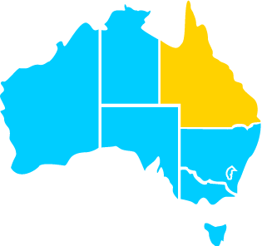
Backgrounding
About my work
Working across all three levels of Aust Govt:
Federal, State & Local
Brisbane

Slide 25
Backgrounding
About the Australian Government’s Big Tech
Our previous Prime Minister said, in 2015:
“Australian government entities will make non-sensitive data open by default to contribute to greater innovation and productivity improvements across all sectors of the Australian economy”

Slide 26
Backgrounding
About the Australian Government’s Big Tech
Our previous Prime Minister said, in 2015:
“Australian government entities will make non-sensitive data open by default to contribute to greater innovation and productivity improvements across all sectors of the Australian economy”
What is being done?

Slide 27
Backgrounding
About the Australian Government’s Big Tech
Our previous Prime Minister said, in 2015:
“Australian government entities will make non-sensitive data open by default to contribute to greater innovation and productivity improvements across all sectors of the Australian economy”
What is being done?
Legal, Governance, Research, Technical, Investment

Slide 28
Reflecting
I presented at NextBigTechAsia 2018:
How Big Data Can Elevate Better Public Service Delivery
The Australian Case Study: Governance of Federated, Federal Data

Slide 29
Reflecting
I presented at NextBigTechAsia 2018:
How Big Data Can Elevate Better Public Service Delivery
The Australian Case Study: Governance of Federated, Federal Data
Today I’m building on both of those:
Australia’s League of Data:
improving public service delivery
it is governed, federated

Slide 30
Reflecting
2018: How Big Data Can Elevate Better Public Service Delivery
Overview:
Public/Private collaboration
Analytics for public service delivery
Real-time data adoption

Slide 31
Reflecting
2018: How Big Data Can Elevate Better Public Service Delivery
Overview:
Public/Private collaboration
Analytics for public service delivery
Real-time data adoption
“No one has all the answers”
This is still the case

Slide 32
Reflecting
2018: How Big Data Can Elevate Better Public Service Delivery
Overview:
Public/Private collaboration
Analytics for public service delivery
Real-time data adoption
Aust Gov is building “analytics hubs”
Going strong but data integration still expensive

Slide 33
Reflecting
2018: How Big Data Can Elevate Better Public Service Delivery
Overview:
Public/Private collaboration
Analytics for public service delivery
Real-time data adoption
“crossing of domains is the key”
Social collaboration more important than technical

Slide 34
Reflecting
2018: The Australian Case Study: Governance of Federated, Federal Data
Overview:
Australian data landscape
Distributed data production
Interoperability
Data harmonisation & integrity
Summary of aims for industry

Slide 35
Reflecting
2018: The Australian Case Study: Governance of Federated, Federal Data
Overview:
Australian data landscape
Distributed data production
Interoperability
Data harmonisation & integrity
Summary of aims for industry
National Innovation & Science Agenda (2015)
Still relevant, longer-term legal & infrastructure investment now

Slide 36
Reflecting
2018: The Australian Case Study: Governance of Federated, Federal Data
Overview:
Australian data landscape
Distributed data production
Interoperability
Data harmonisation & integrity
Summary of aims for industry
Then planned
Now underway!

Slide 37
Reflecting
2018: The Australian Case Study: Governance of Federated, Federal Data
Overview:
Australian data landscape
Distributed data production
Interoperability
Data harmonisation & integrity
Summary of aims for industry
Focus of the Linked Data WG, then and now.
Growing interest in the approach

Slide 38
Reflecting
2018: The Australian Case Study: Governance of Federated, Federal Data
Overview:
Australian data landscape
Distributed data production
Interoperability
Data harmonisation & integrity
Summary of aims for industry
Then, specific approaches described
Now, partly implemented

Slide 39
Reflecting
2018: The Australian Case Study: Governance of Federated, Federal Data
Overview:
Australian data landscape
Distributed data production
Interoperability
Data harmonisation & integrity
Summary of aims for industry
“Government data should be…”
…what we are trying to make it now

Slide 40
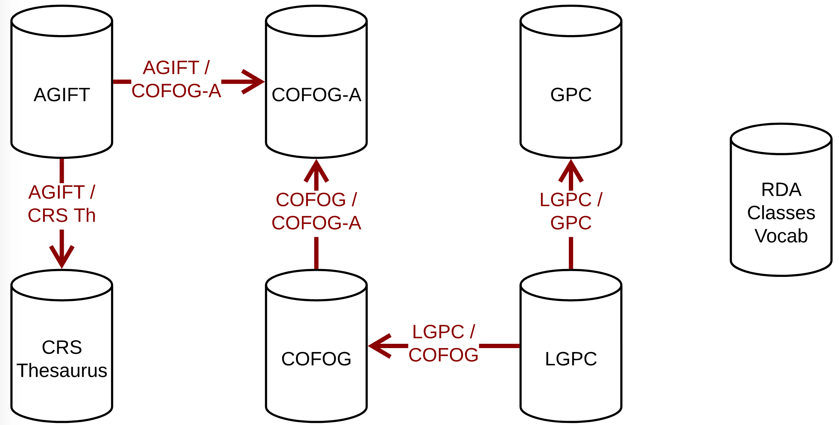
Australian Government: League of Data
Mapped and un-mapped government function datasets in LongSpine

Slide 41
League of Data
Government Data
Business Data
Environmental Data
Aust. National government is committed to three main types of data

Slide 42
League of Data – “hubs”
Government Data
Business Data
Environmental Data
Themed large, secure environments for data analytics

Slide 43
League of Data – “spines”
Government Data
Business Data
Environmental Data
Reference points for data cross-linking

Slide 44
League of Data – “spines”
Government Data
Business Data
Environmental Data
This is my area!
Reference points for data cross-linking

Slide 45
League of Data – location spine
Government Data
Business Data
Environmental Data
Almost everything is somewhere

Slide 46
League of Data – structural spines
Government Data
Business Data
Environmental Data
All government data relates to government

Slide 47
League of Data – spine of spines
Government Data
Business Data
Environmental Data
Mechanics for data identity link everything

Slide 48
Spines rollout
Select mechanics for identity

Slide 49
Spines rollout
Select mechanics for identity

Slide 50
Spines rollout
Select mechanics for identity
common data formats and exchange protocols on the Web

Slide 51
Spines rollout
Select mechanics for identity
common data formats and exchange protocols on the Web
web of data

Slide 52
Spines rollout
Select mechanics for identity
common data formats and exchange protocols on the Web
an integrated set of formal data models

Slide 53
Spines rollout
Select mechanics for identity
common data formats and exchange protocols on the Web
an integrated set of formal data models
Modern data modelling, regardless of the web component

Slide 54
Spines rollout
Select mechanics for identity
Provide specific things with identity
Spatial
Organisational

Slide 55
Spines rollout
Select mechanics for identity
Provide specific things with identity
Spatial
Spatial Linking Authority – being formed for creating authoritative IDs

Slide 56
Spines rollout
Select mechanics for identity
Provide specific things with identity
Spatial
Spatial Linking Authority – being formed for creating authoritative IDs
LocI – integrated spatial datasets, ever increasing

Slide 57
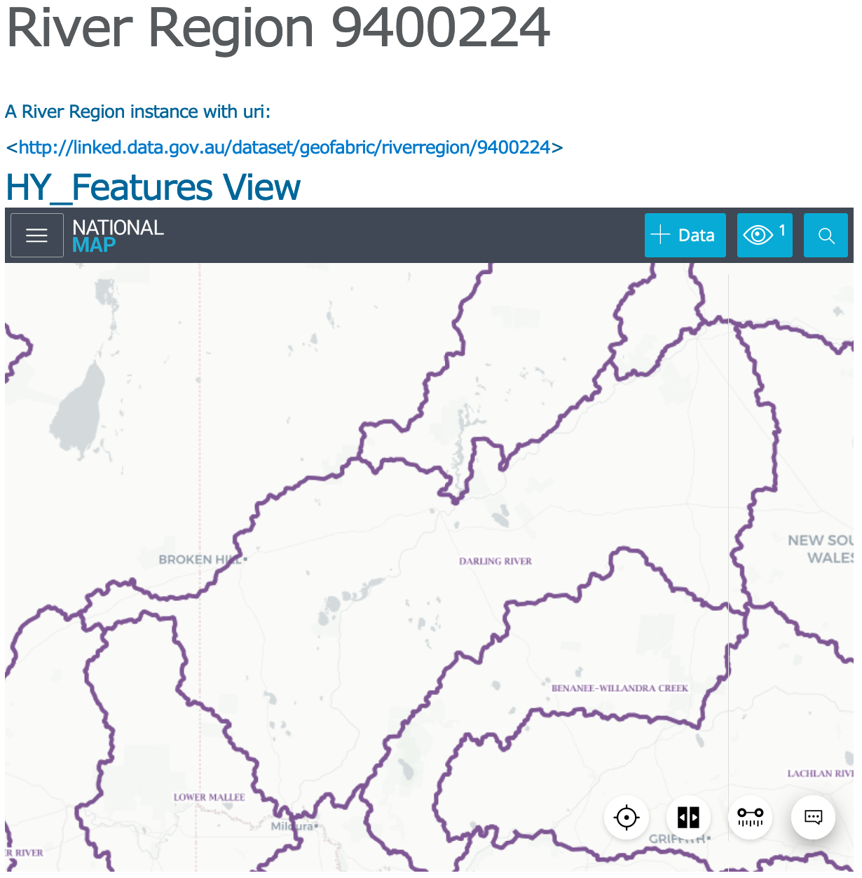
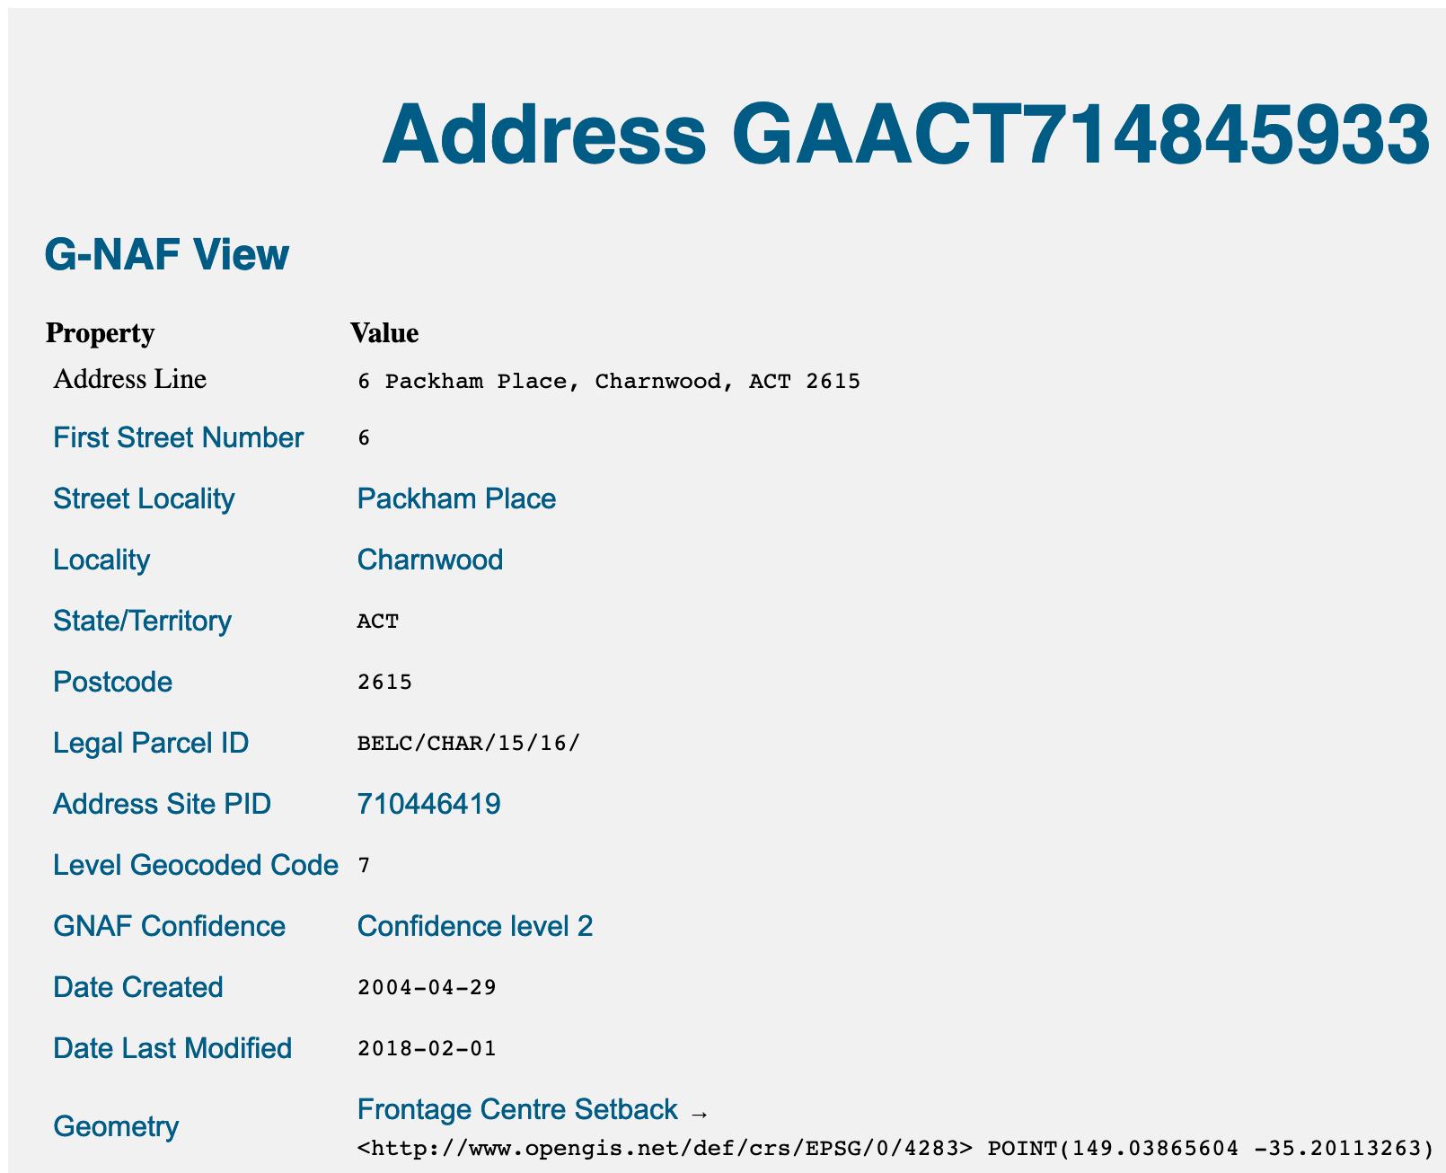
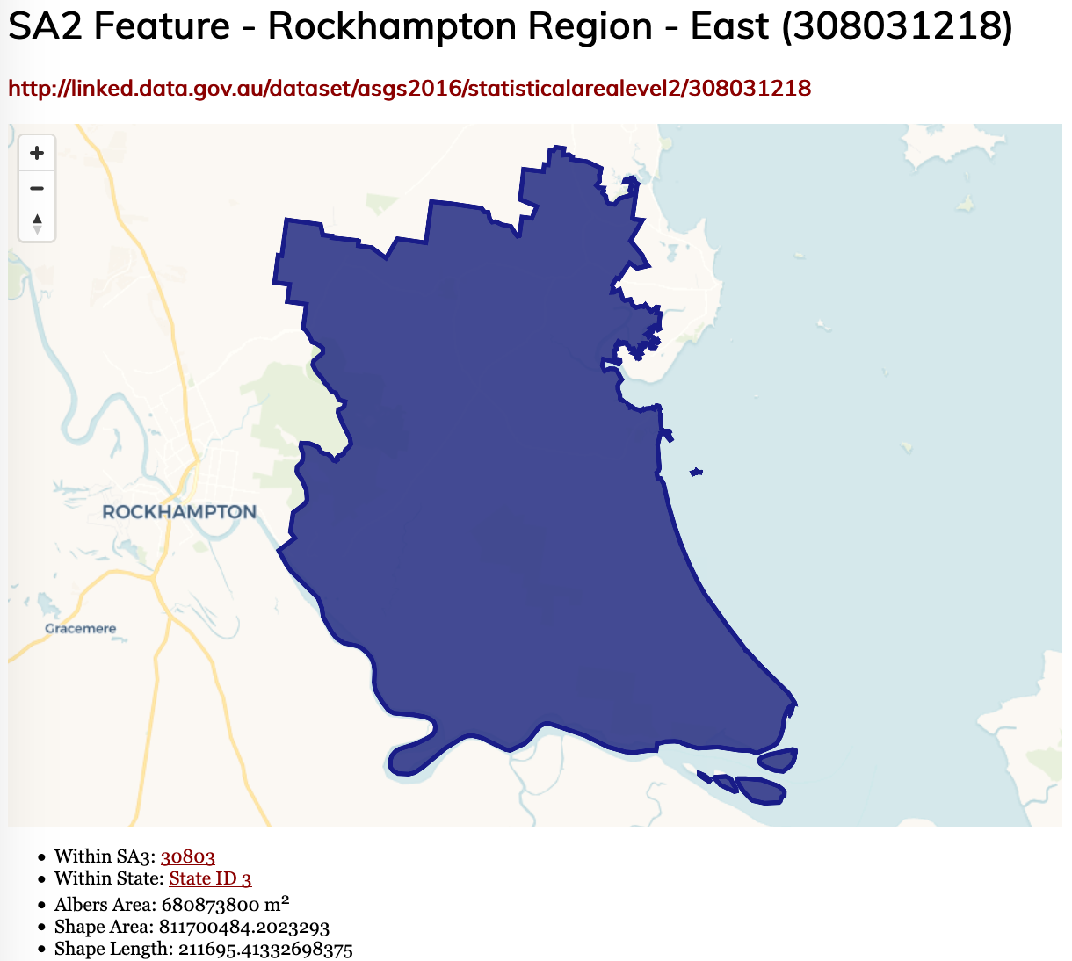
Spines rollout - LocI
Environmental data
– Geofabric
Address data
- GNAF
Statistical areas
- ASGS

Slide 58
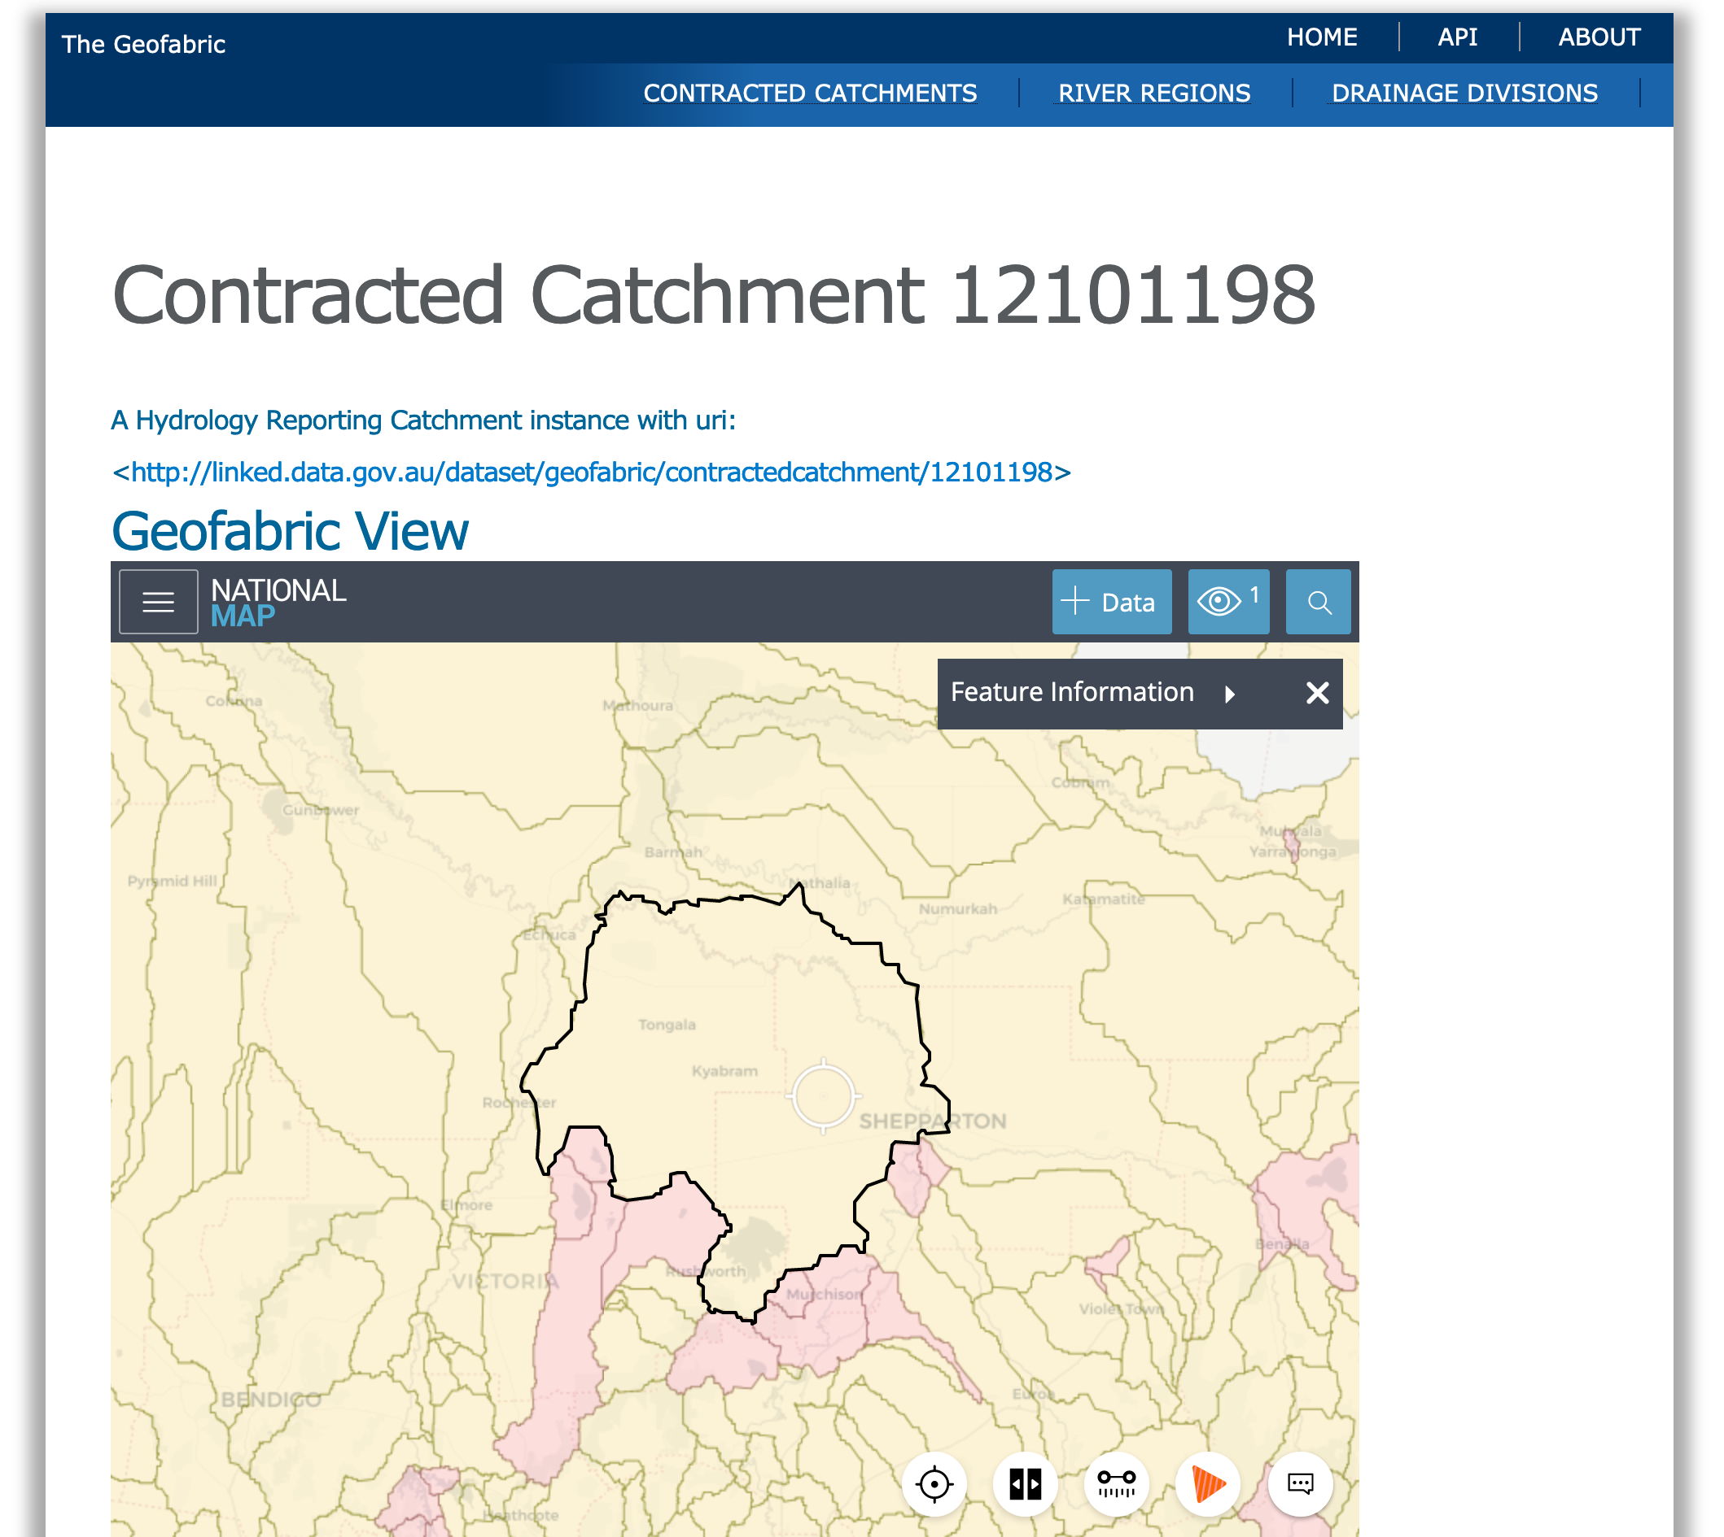
Spines rollout – LocI - Geofabric
Previously already public data
Now public semantic data

Slide 59
Spines rollout – LocI - Geofabric
Previously already public data
Now public semantic data
All items formally defined
A “Catchment” and how they relate to other things is given

Slide 60
Spines rollout – LocI - Geofabric
Previously already public data
Now public semantic data
All items formally defined
All individual things have web addresses
http://linked.data.gov.au/contractedcatchment/12101198

Slide 61
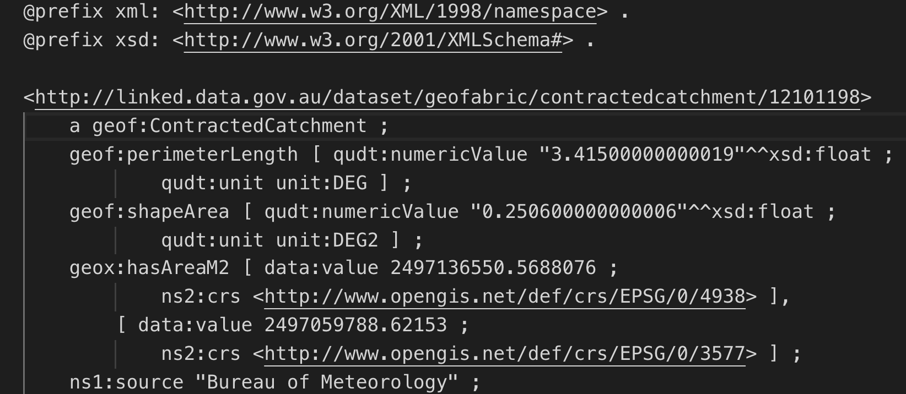
Spines rollout – LocI - Geofabric
Previously already public data
Now public semantic data
All items formally defined
All individual things have web addresses
Human & machine versions of data
https://liked/data.giv.au/contractedcatchment/12101198

Slide 62
Spines rollout
Select mechanics for identity
Provide specific things with identity
Spatial
Organisational

Slide 63
Spines rollout - LongSpine
Multiple structural taxonomies mapped

Slide 64
Spines rollout - LongSpine
Multiple structural taxonomies mapped
Mappings published separately for individual governance

Slide 65
Spines rollout - LongSpine
Multiple structural taxonomies mapped
Mappings published separately for individual governance
This is a dataset

Slide 66
Spines rollout - LongSpine
Multiple structural taxonomies mapped
Mappings published separately for individual governance
Models formalised and aligned

Slide 67
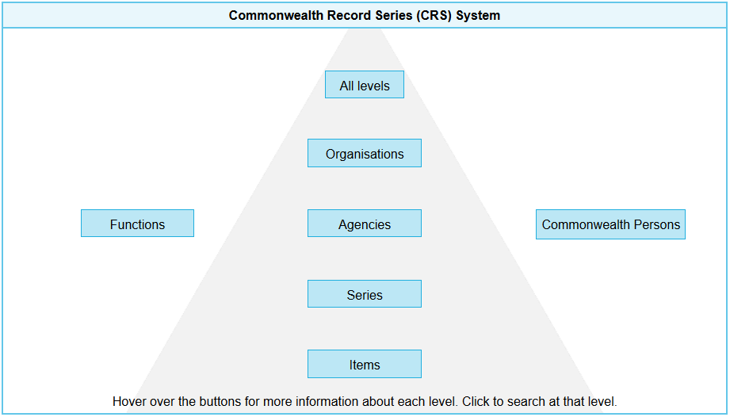
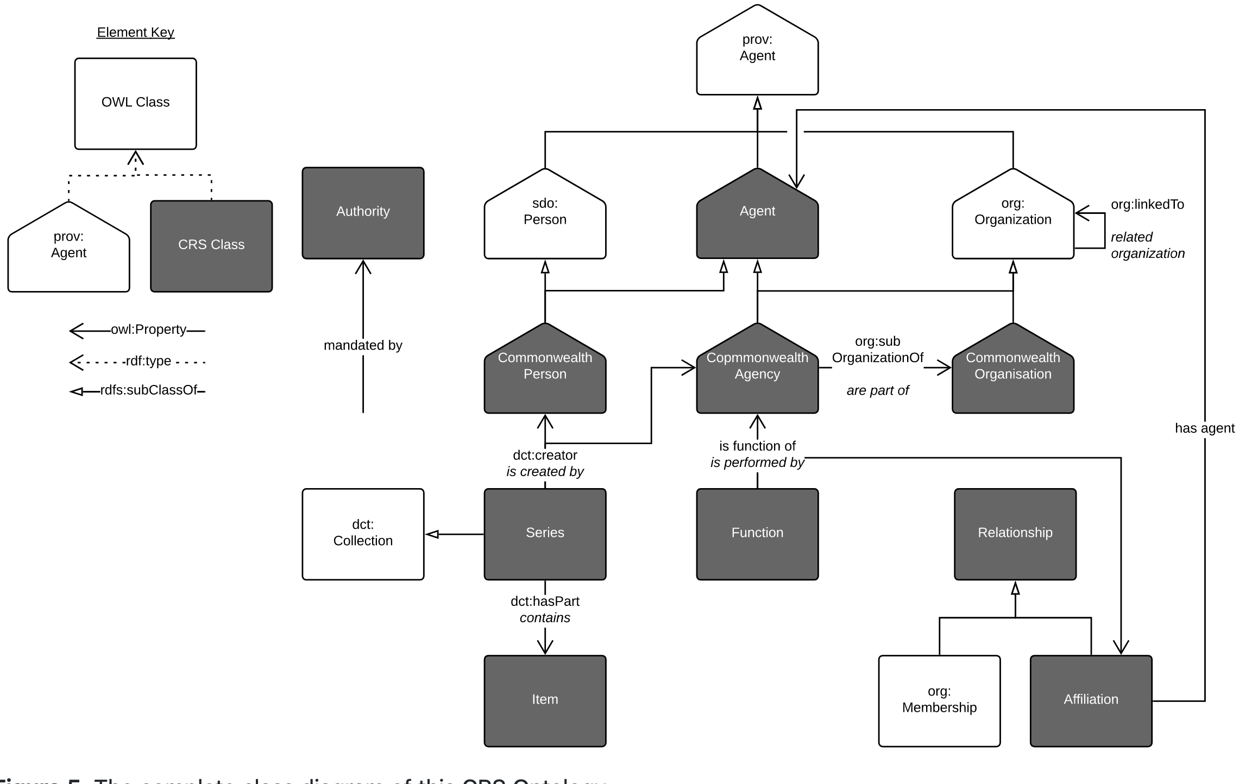
Informal to Formal

Slide 68
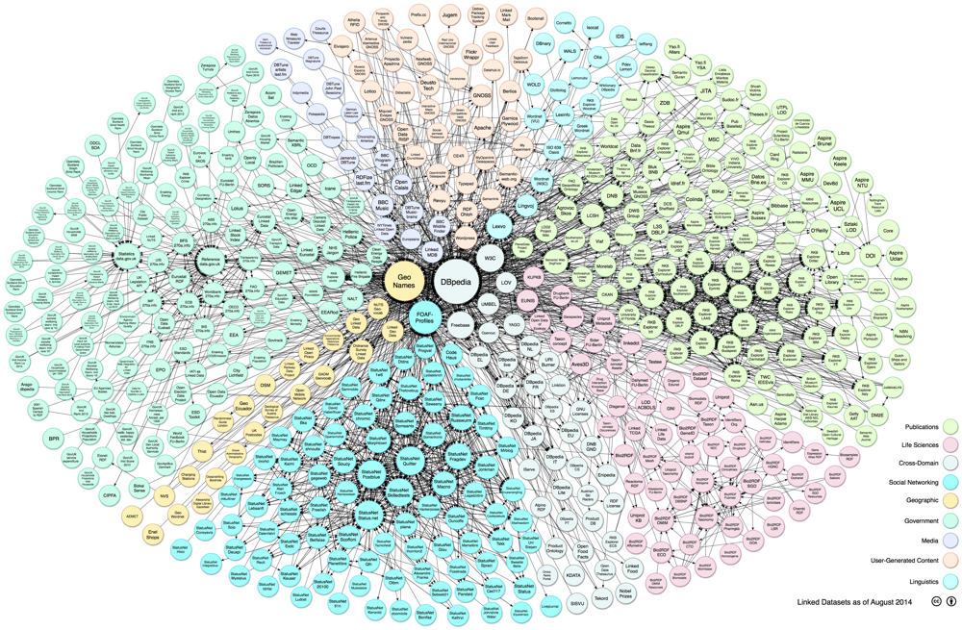
Spines status
8 formal data models
9 major datasets published as Semantic Data
17 Linksets
20+ vocabularies of terms
30M+ identifiers
2B+ machine-readable statements
https://lod-cloud.net

Slide 69
Spines status
8 formal data models
9 major datasets published as Semantic Data
17 Linksets
20+ vocabularies of terms
30M+ identifiers
2B+ machine-readable statements
We have an Australian Linked Data cloud forming!
https://lod-cloud.net

Slide 70
Spines status
8 formal data models
9 major datasets published as Semantic Data
17 Linksets
20+ vocabularies of terms
30M+ identifiers
2B+ machine-readable statements
And these are just the reference datasets…
https://lod-cloud.net

Slide 71
Spines governance
Distributed by nature

Slide 72
Spines governance
Distributed by nature
Everyone must follow the rules

Slide 73
Spines governance
Distributed by nature
Everyone must follow the rules
Some rules are now becoming compulsory

Slide 74
Spines governance
Distributed by nature
Everyone must follow the rules
Some rules are now becoming compulsory
We are establishing reference data authorities

Slide 75
Spines governance
Distributed by nature
Everyone must follow the rules
Some rules are now becoming compulsory
We are establishing reference data authorities
We are all hoping for data committees secretariat management

Slide 76
Spines future
“numerical” data coming online as semantic data
Census data
Sensor data
Government analysis data
Cubes of data referencing the spine’s IDs and types

Slide 77
Spines future
“numerical” data coming online as semantic data
Data analytics within the
secure hubs
IDs work just fine within secure (non-open) data environments

Slide 78
Summary points
The Australian government is building a League of Data

Slide 79
Summary points
The Australian government is building a League of Data
It is driven by a long-standing open data policy

Slide 80
Summary points
The Australian government is building a League of Data
It is driven by a long-standing open data policy
With continuing legal development

Slide 81
Summary points
The Australian government is building a League of Data
It is driven by a long-standing open data policy
With continuing legal development
Hubs and Spines are being built

Slide 82
Summary points
The Australian government is building a League of Data
It is driven by a long-standing open data policy
With continuing legal development
Hubs and Spines are being built
Technology choices have been made

Slide 83
Summary points
The Australian government is building a League of Data
It is driven by a long-standing open data policy
With continuing legal development
Hubs and Spines are being built
Technology choices have been made
Data is already being published in 2 spines

Slide 84
Summary points
The Australian government is building a League of Data
It is driven by a long-standing open data policy
With continuing legal development
Hubs and Spines are being built
Technology choices have been made
Data is already being published in 2 spines
Data authorities are being established to manage parts

Slide 85
Homework questions
Do you know about the Semantic Web?
Does your government have a Linked Data Working Group?
Would contacting the AGLDWG help you?

