Slide 1
ANSIS Vocabularies
Simon J D Cox
CSIRO Land and Water
Megan Wong
Federation University
Linda Gregory
CSIRO Agriculture and Food

Slide 2
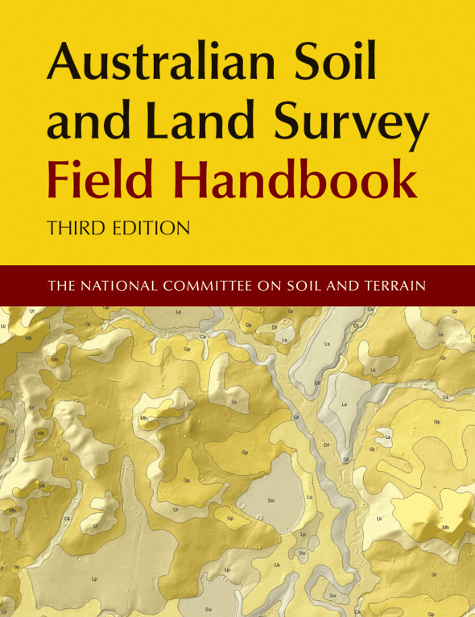
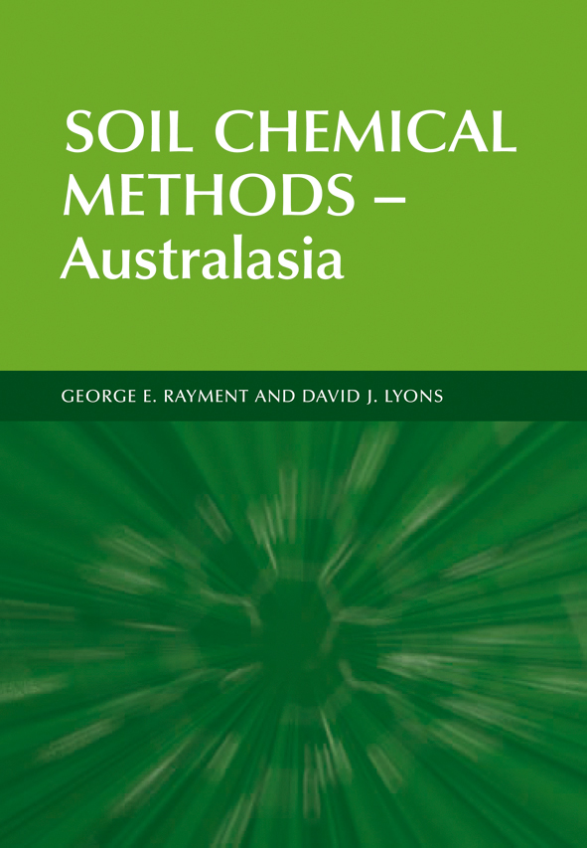
1996, 2016, 2021
1984, 1990, 2009, 2022?
1992, 2011

Slide 3
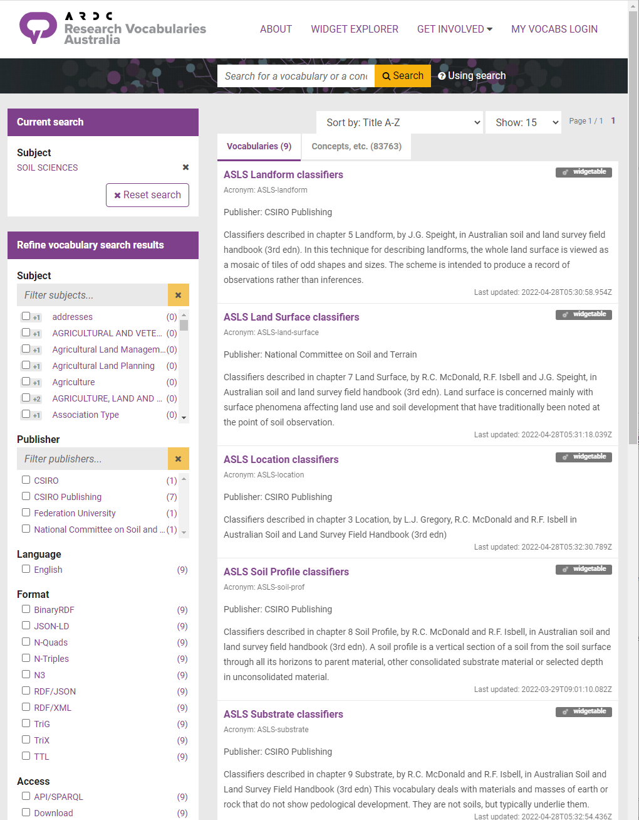
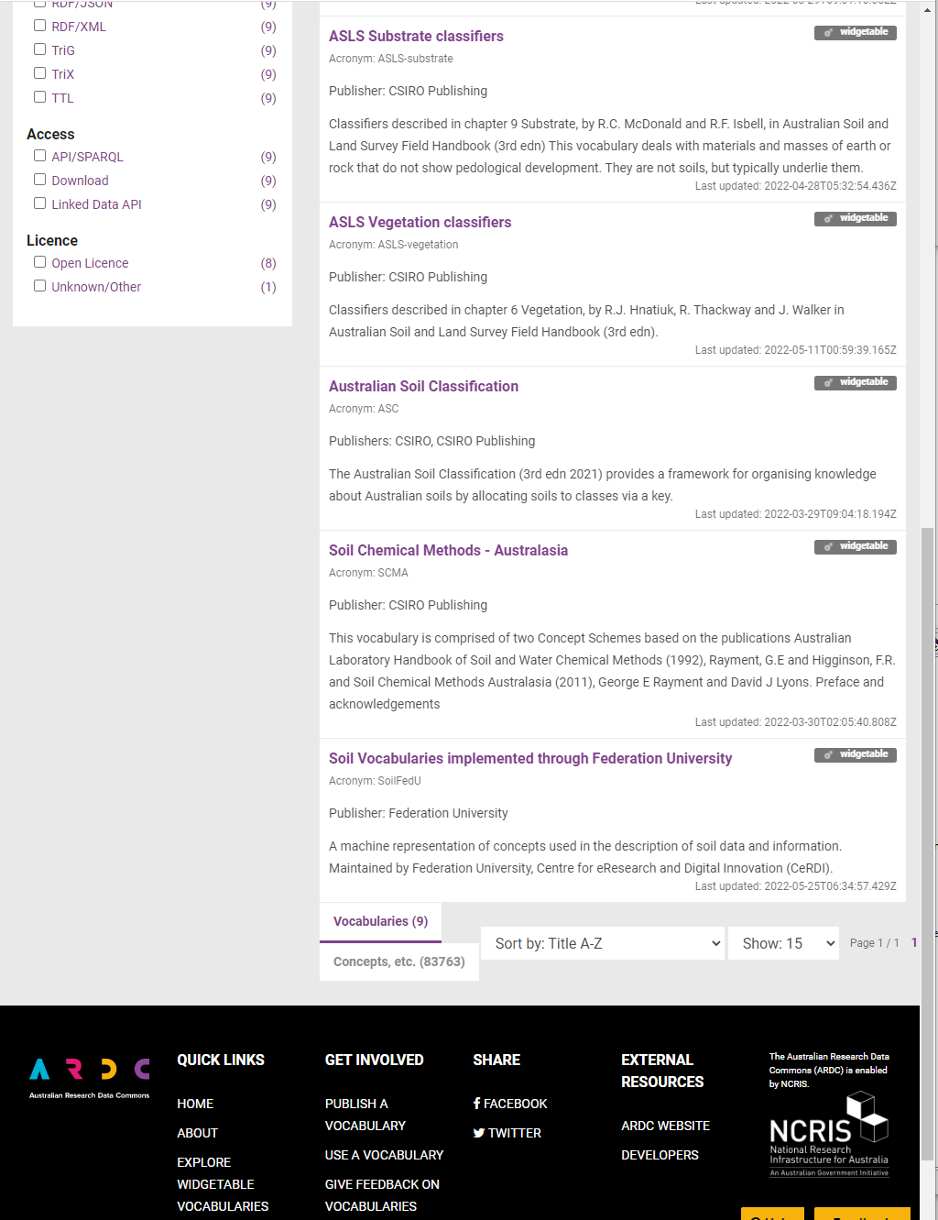
Soil science vocabularies at RVA
https://vocabs.ardc.edu.au/search/#!/?v_subject_labels=SOIL%20SCIENCES

Slide 4
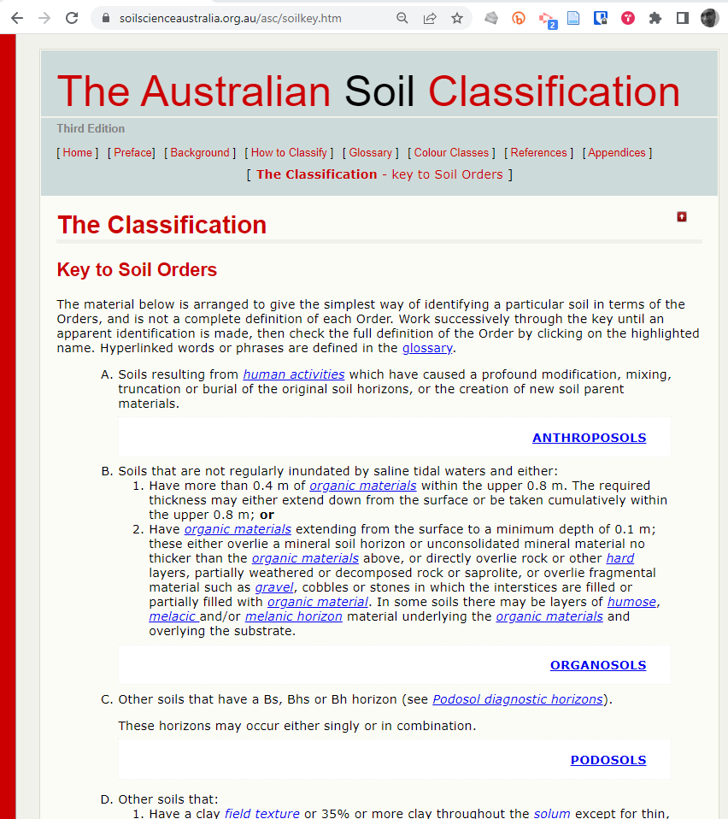
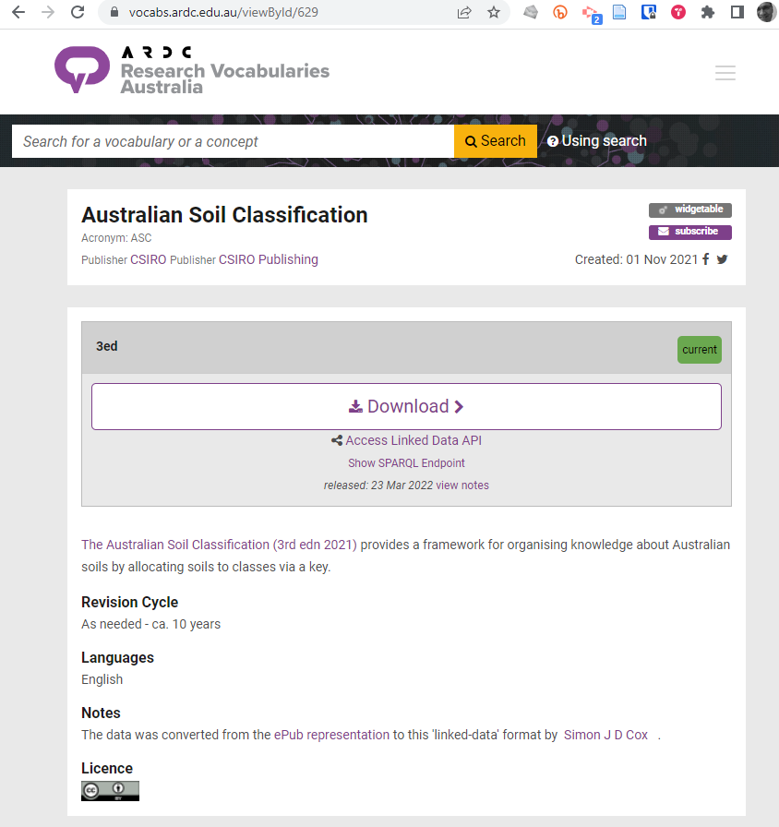
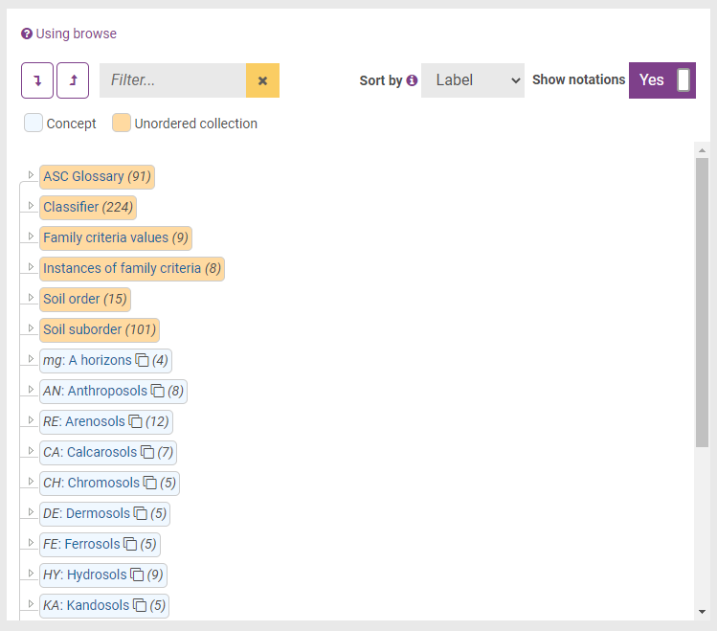
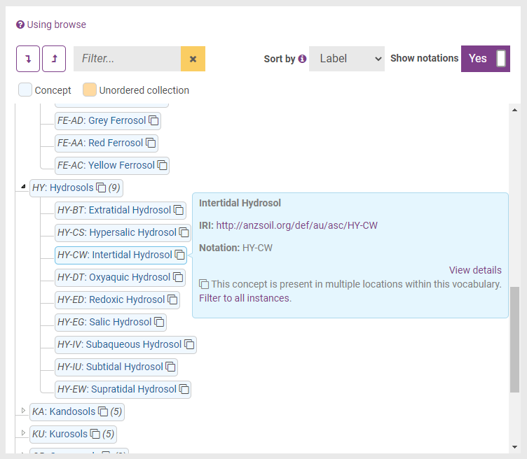

Slide 5
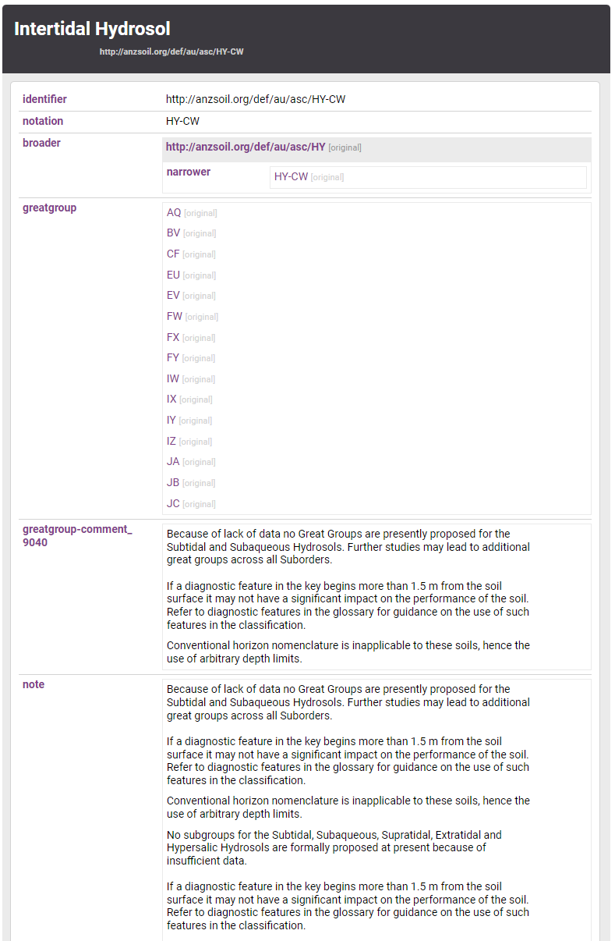
ASC @ RVA
- This URI permanently denotes the concept
- Complete enumeration of sub-orders
- Description enumerates the valid great-groups, sub-groups, families for the sub-order
Use this URI for the ‘browse’ view
http://anzsoil.org/def/au/asc-browse

Slide 6
Machine readable
Download each separate concept
Or the vocabulary as-a-whole
Or access the SPARQL Endpoint

Slide 7
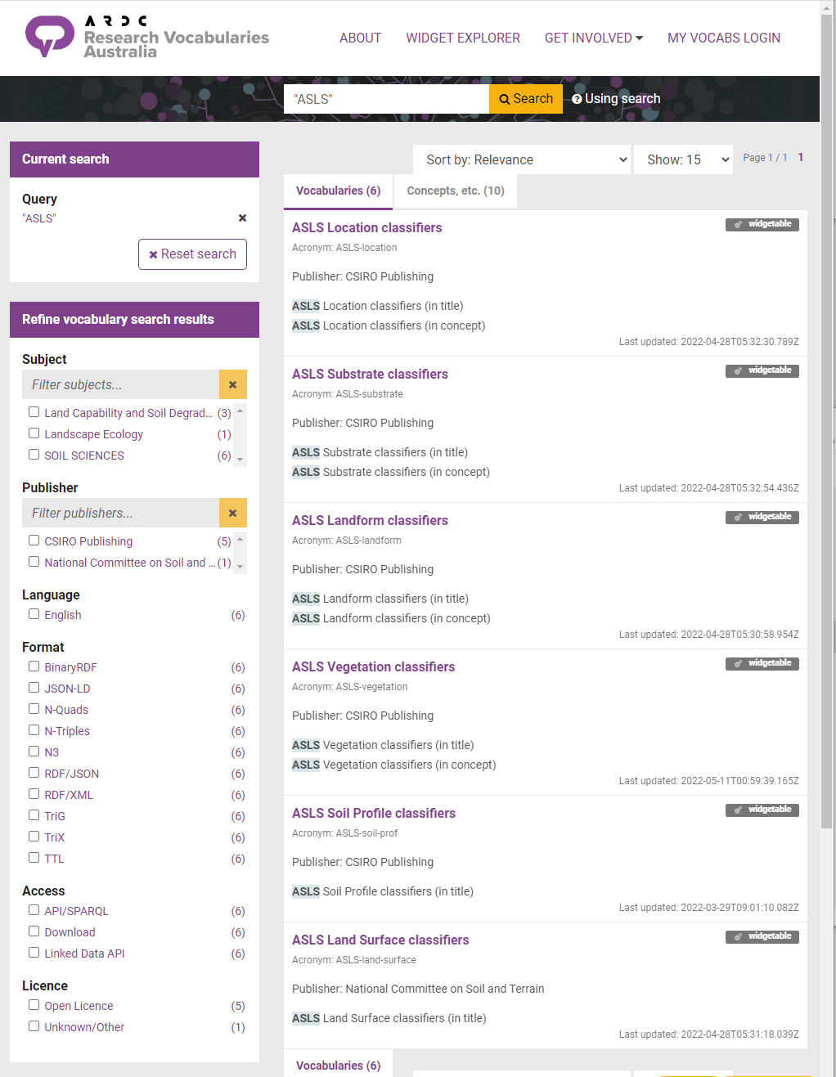
ASLS – third edition
Each chapter is (currently) a separate vocabulary:
different authors ➔ different attribution and governance
https://vocabs.ardc.edu.au/search/#!/?q=“ASLS”

Slide 8
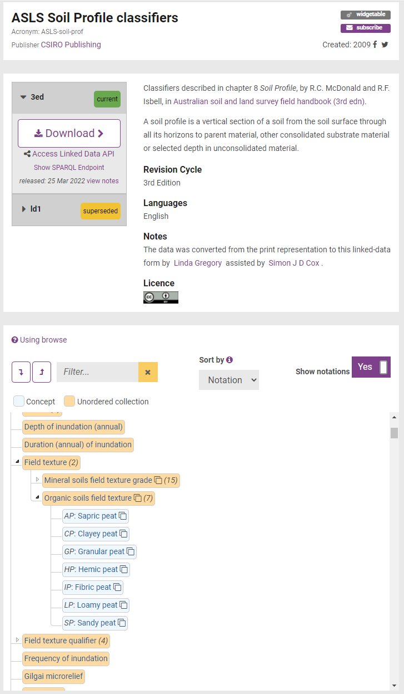
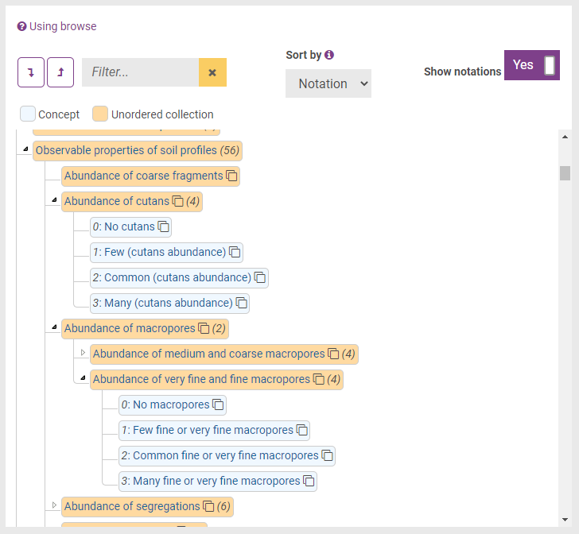
ASLS Soil Profile
Hierarchical arrangement reflects ordering within the chapter

Slide 9
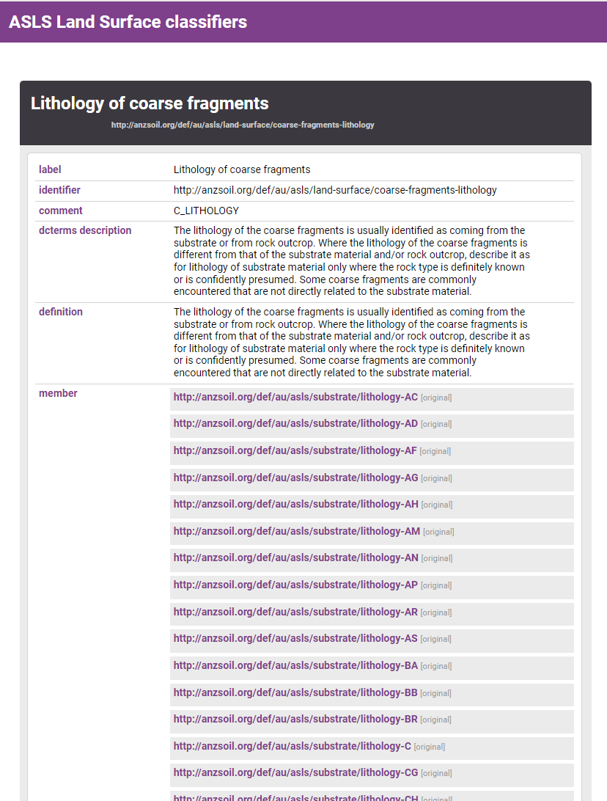
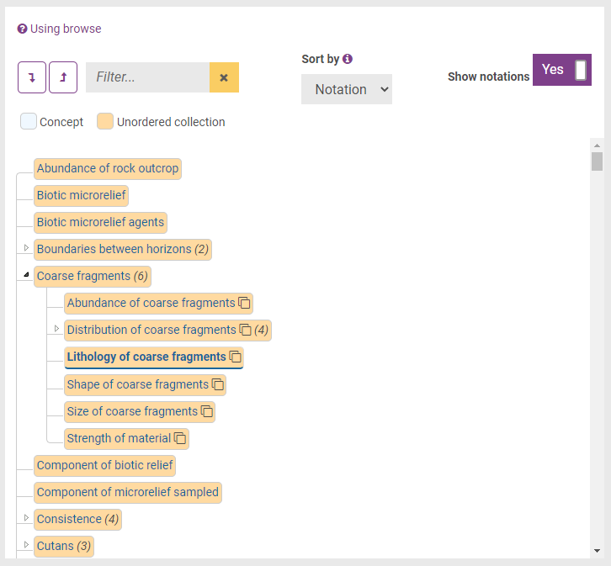
ASLS
Cross-reference between chapters where necessary

Slide 10
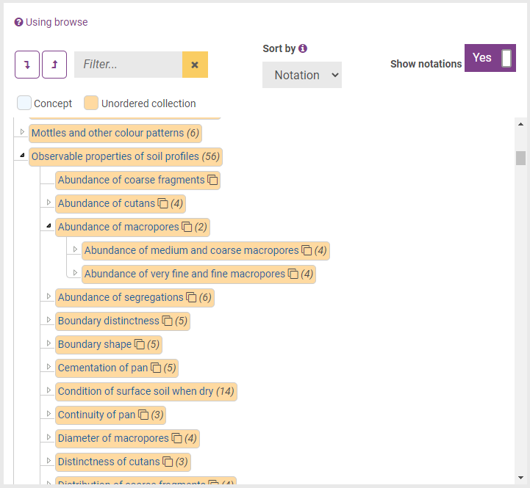
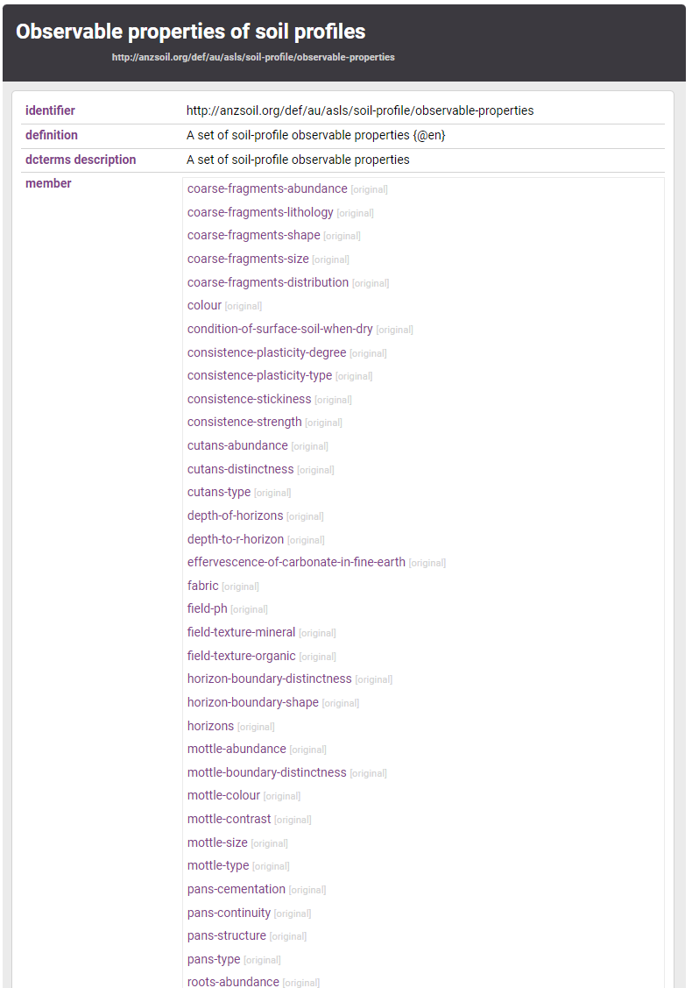
‘Observable properties’

Slide 11
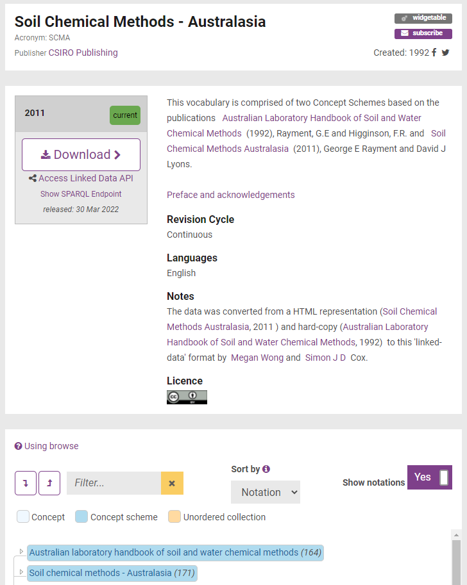
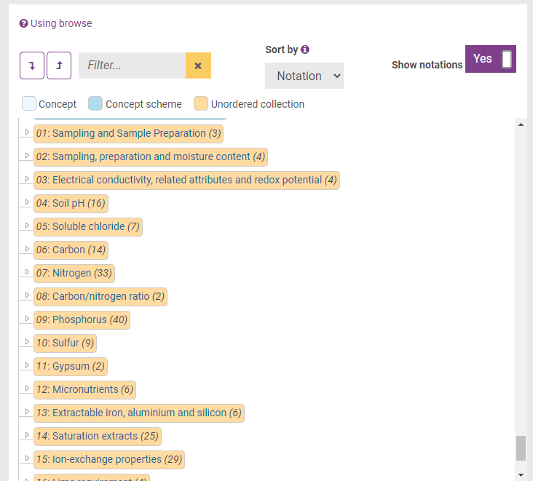
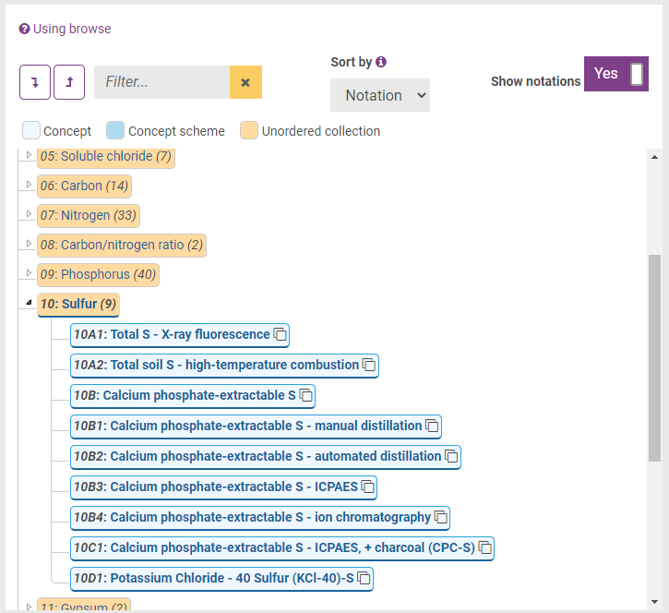
Soil Chemical Methods
Two editions
SWCM
SCMA
URIs don’t change for methods carried over
Some methods retired

Slide 12
Maintaining the soil vocabularies
ASC & ASLS
revision recent or pending
SCM
no planned update

Slide 13
How does the revision process work?
How is the normative content represented? – in a document, spreadsheet, database … Where is it stored?
Who manages the normative content?
Who can propose changes?
How are change proposals recorded? – tracker, tickets, issues
How are change proposals evaluated? How much consultation? Is the deliberation public or private? How is consensus reached?
How is a new release (edition) scheduled? How are editions denoted (e.g. number, name)?
What are the products and how are they generated? (book, database, website, FAIR vocabulary)
Is the FAIR representation (i.e. RDF/SKOS file) different to the normative artefact? How is the FAIR representation synched?
How is the FAIR version online updated?

Slide 14
General patterns in maintaining a FAIR vocabulary
Concerns
Scope and Context
Stakeholders
Content Management arrangements
Change Requests, Revisions and Releases
Change Implementation and Communication
Persistence and Sustainability
Roles
Owner agency, learned society, or another peak body
Sponsor
Publisher commercial rights holder
Steward manages revision of content
Contributor submit content changes
Reviewer evaluate change proposals
Custodian manages normative artefacts
Users discipline, jurisdiction, market, project team
Maintainers of a dependent vocabulary
Potential users if changes to status, content or presentation
Service administrator
Service host

Slide 15
Maintaining the soil vocabularies
ASC
revision 2021
Owner: NCST
Steward: Noel Schoknecht
Contributors: ?
Reviewers: ?
FAIR Custodian: ANSIS
Release strategy: vocabulary as-a-whole is a new numbered edition
ASLS
revision pending (2022?)
Owner: NCST
Steward: Andrew Biggs
Contributors: Ben Sparrow, NCST
Reviewers: NCST
FAIR Custodian: ANSIS
Release strategy: vocabulary as-a-whole is a new numbered edition
SCM
no update of SCMA is planned
Registry solution?

Slide 16
Soil Chemical Methods
Revision history and plans
Editions have different names –
SWCM 1992
SCMA 2011
Method codes are preserved
No plans for a new print edition
N.B. Methods (and codes) currently imply a combined procedure and analyte
What are the actual requirements?
Accessible description of every method mentioned in any dataset
A way to find a suitable method
A way to register a new method
Who is authorized to propose?
Can a standard structure be implemented as a Form?
Is a reference to a paper or lab manual acceptable?
Who validates a new proposal?
Separate procedures from analytes
Analytes should reference an external source – CAS or ChEBI

Slide 17
Vocabulary dependencies
QUDT
ChEBI

Slide 18
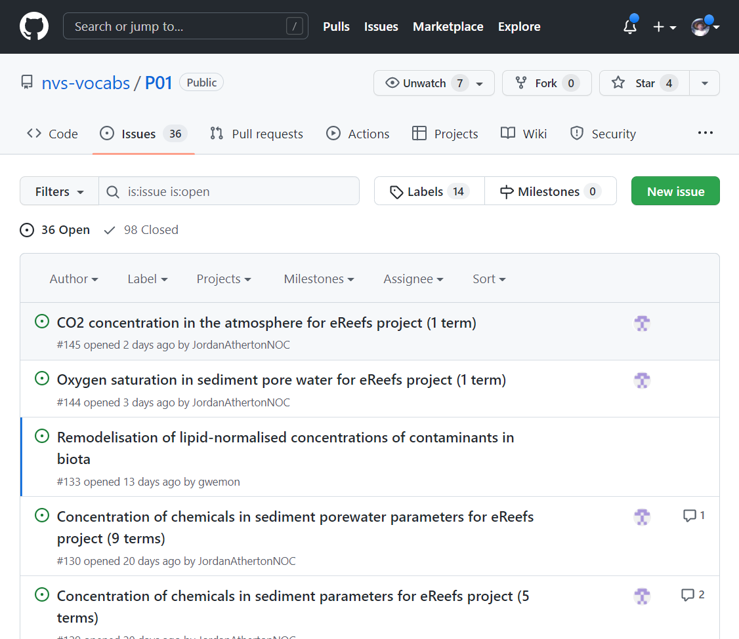
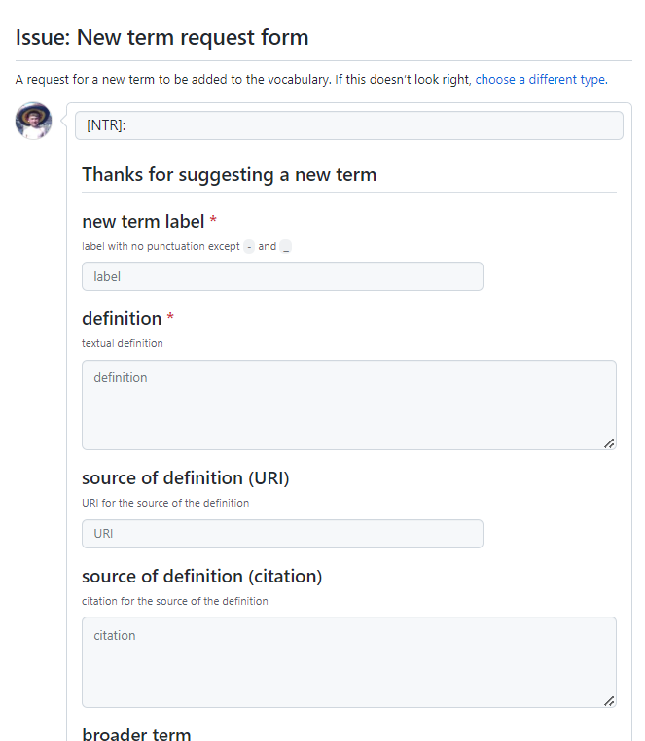
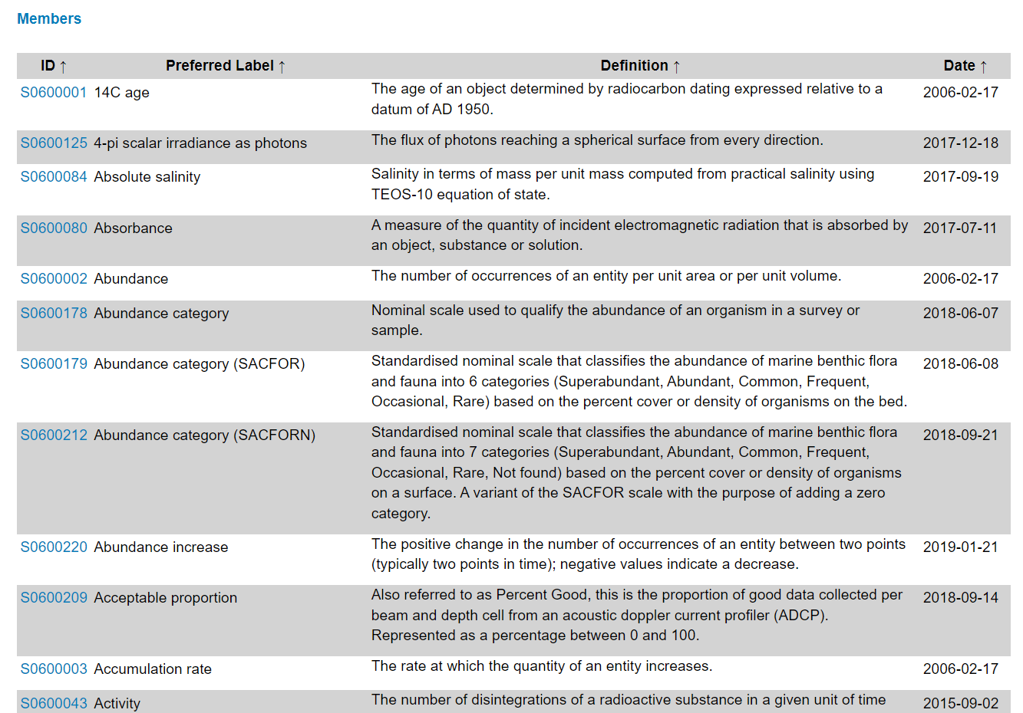
Example of community governance process

