Slide 1
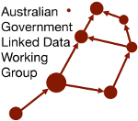
AGLDWG AGM 2026
Project Presentations
Multiple AGLDWG Members

Slide 2
Speakers
Melinda Hodkiewicz
Les Kneebone
Matt Duckham
Edmond Chuc
Heidi Leow
Nicholas Car
Alastair Paton
Adib Rohani
Jamie Feiss
Javier Sanchez Gonzalez

Slide 3
Ontology-based interoperability of standards
Speaker: Melinda Hodkiewicz, UWA

Slide 4
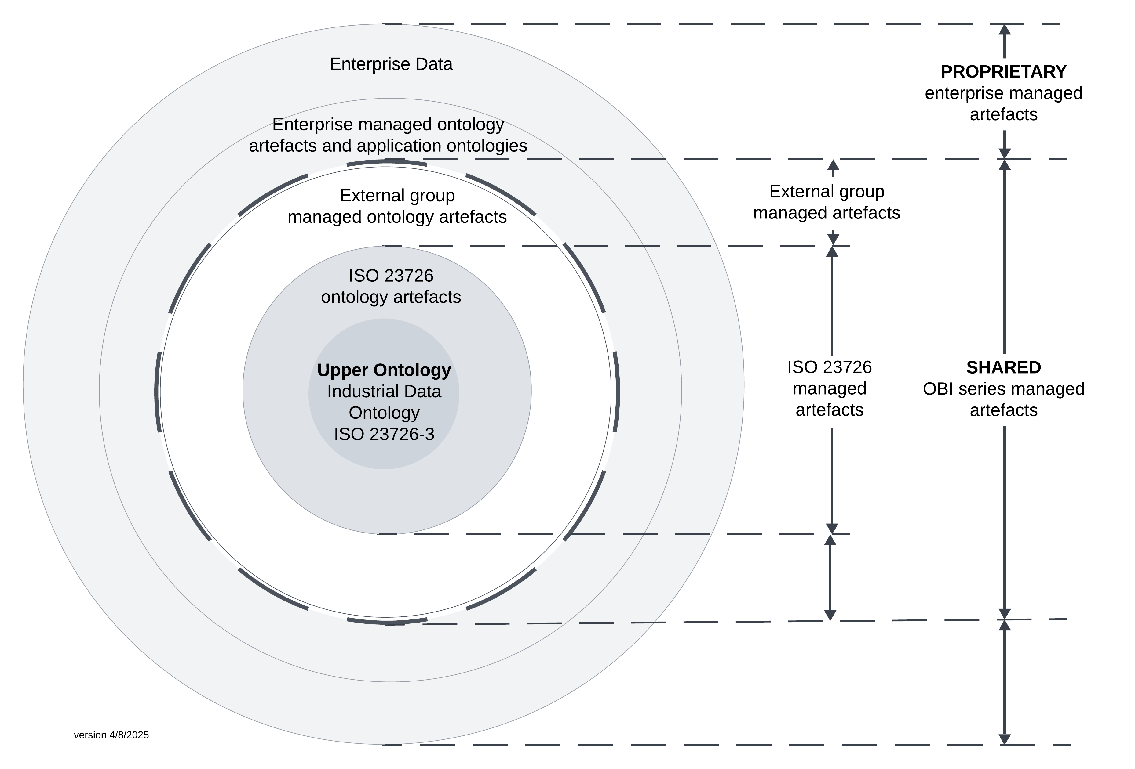
Why the Industrial automation systems and integration – Ontology based interoperability (OBI) standards?
The Ontology based interoperability (OBI) standards facilitate digitization in long-life, asset-intensive industries through a shared, digital representation of a system's physical and functional structures and interdependencies, and data captured as part of design, purchase, operation, and maintenance decisions through the life cycle.
Each part of the new standard utilizes IDO aligned models to represent knowledge, structured as OWL 2 DL compliant ontologies.

Slide 5
ISO/CD 23726-1 Overview and fundamental principles
Clause 1: Scope
Clause 2: Normative references
Clause 3: Terms and definitions
Clause 4: Parts of the OBI series
4.1 Overview and fundamental principles
4.2 Vocabulary
4.3 Industrial data ontology
4.4 Schedule data ontology
Clause 5: OBI ecosystem
5.1 General
5.2 Stakeholders in the OBI ecosystem
5.3 Reference ontologies
5.4 Ontology alignment
5.5 Reference data libraries
5.6 Reference to Semantic Web technologies
5.7 RDF vocabularies
5.8 Modelling templates, patterns and data quality rules-
For more information:
A pre-ISO submission version of Part 1 is available at:
https://pca-posc-caesar-association.github.io/Public_ISO23726-1/latest/
An FDIS version of the ISO ttl file is available at
https://posccaesar.org/articles/fdis-version-of-ido---industrial-data-ontology-now-available-for-download-as-a-file
Contact: Melinda.Hodkiewicz@uwa.edu.au
Clause 6: Fundamental principles and requirements
6.1 Direct Semantics consistent
6.2 Resource description framework
6.3 Digital resource
6.4 Axioms, rules and constraints
6.5 Ontology alignment, review and documentation
6.6 Annotation
6.7 Versioning and storage of artefacts
6.8 Ontology modularisation and re-use
6.9 Ontology evaluation
6.10 Ontology maintenance agencies and process
Clause 7: Grounding in mathematical logic
Clause 8: Ontology namespace, formatting and annotation guidelines
8.1 Ontology identifier structure and namespace
8.2 Ontology subdirectory structure
8.3 Namespace for ontology resources
8.4 Otology prefixes
8.5 Class names
8.6 Object property names
8.7 Data property names
8.8 Alignment ontologies
Clause 9: Annotation properties

Slide 6
Modelling ATED as a Semantic Web vocabulary
Speaker: Les Kneebone, KurrawongAI

Slide 8
Linked Data Road Networks
Speaker: Matt Duckham, RMIT

Slide 9
Modernising GraphDB GeoSPARQL with Apache Jena
Speaker: Edmond Chuc, KurrawongAI

Slide 10

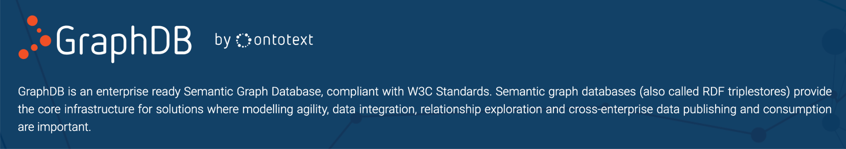
Modernising GraphDB GeoSPARQL with Apache Jena
GraphDB
  Knowledge graph product of Graphwise
OGC GeoSPARQL
  Standard way to handle spatial data

Slide 11

Why modernise the plugin?
Issues
  Replace uSeekM GeoSPARQL 1.0 module
    Unsupported software, last updated 13 years ago
  Fix fundamental CRS issues - coercing to CRS84
Solution: use Apache Jena’s GeoSPARQL module as the base

Slide 12
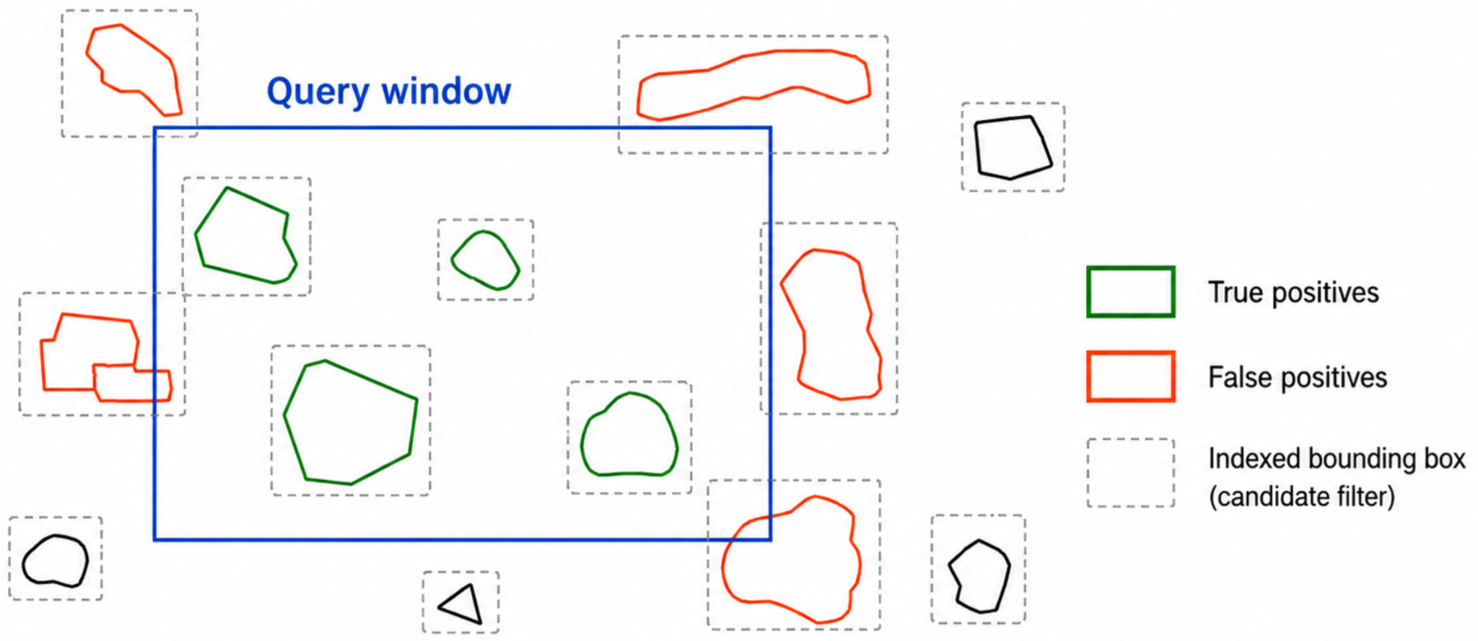
Spatial index and exact evaluation
Source geometry + CRS
GeoSPARQL query
Candidate lookup
(Lucene spatial index)
Exact evaluation
(Previously uSeekM, now Apache Jena)
PREFIX geo: <http://www.opengis.net/ont/geosparql#>
SELECT ?geometry
WHERE {
?geometry geo:sfIntersects """
POLYGON((
152.90 -27.60,
153.20 -27.60,
153.20 -27.30,
152.90 -27.30,
152.90 -27.60
))
"""^^geo:wktLiteral .
}

Slide 13
Performance
Index
  Build - 22% faster
  Size - 10% smaller
Large sfWithin queries - 50.6x faster
Selective sfWithin and sfIntersects queries - 2.2x to 2.5x faster
Other queries - comparable - less than 1 second
Maldives OpenStreetMap RDF benchmark · 769,208 geometries · GraphDB 11.4

Slide 14
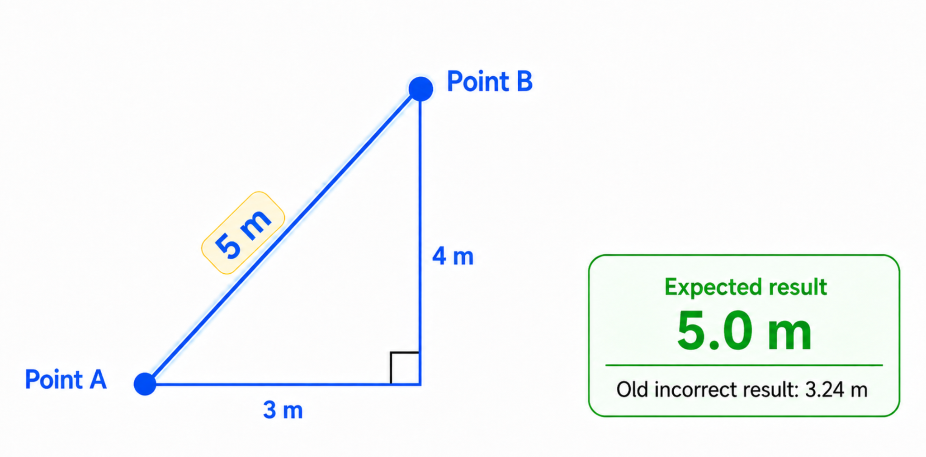
GeoSPARQL correctness
Topological and geometric queries now evaluate correctly using GeoSPARQL semantics

Slide 15
Conclusion
GraphDB correct GeoSPARQL handling
Commercial investment in open source technologies
Links:
GraphDB GeoSPARQL Plugin:
  https://github.com/Ontotext-AD/graphdb-geosparql-plugin
GraphDB GeoSPARQL Benchmark:
  https://github.com/Kurrawong/graphdb-geosparql-benchmark
Apache Jena:
  https://github.com/apache/jena

Slide 16
Carapace
Speaker: Heidi Leow, UWA

Slide 18
RDFLib & Family
Speaker: Nicholas Car, KurrawongAI

Slide 19



RDFLib: Open-Source Python package for working with RDF
Quickstart
Roles Easy scripting, teaching, infracode, W3C proofs
History/Future 2002 – now! / 8.0.0 in 2026. Python & W3C influences forward
Family https://rdflib.dev, but now also kurra & KGM
Click me:
https://rdflib.dev
from rdflib import Graph
g = Graph()
g.parse(“my-file.ttl”)
for r in g.subjects((RDF.type, SKOS.Concept)):
print(r[0])

Slide 20
AGLDWG/Finance CA3 Project Peer Review
Speaker: Alastair Paton, independent

Slide 22
Producing High-Quality Semantic Representations of Standards
Speaker: Adib Rohani, UWA

Slide 23
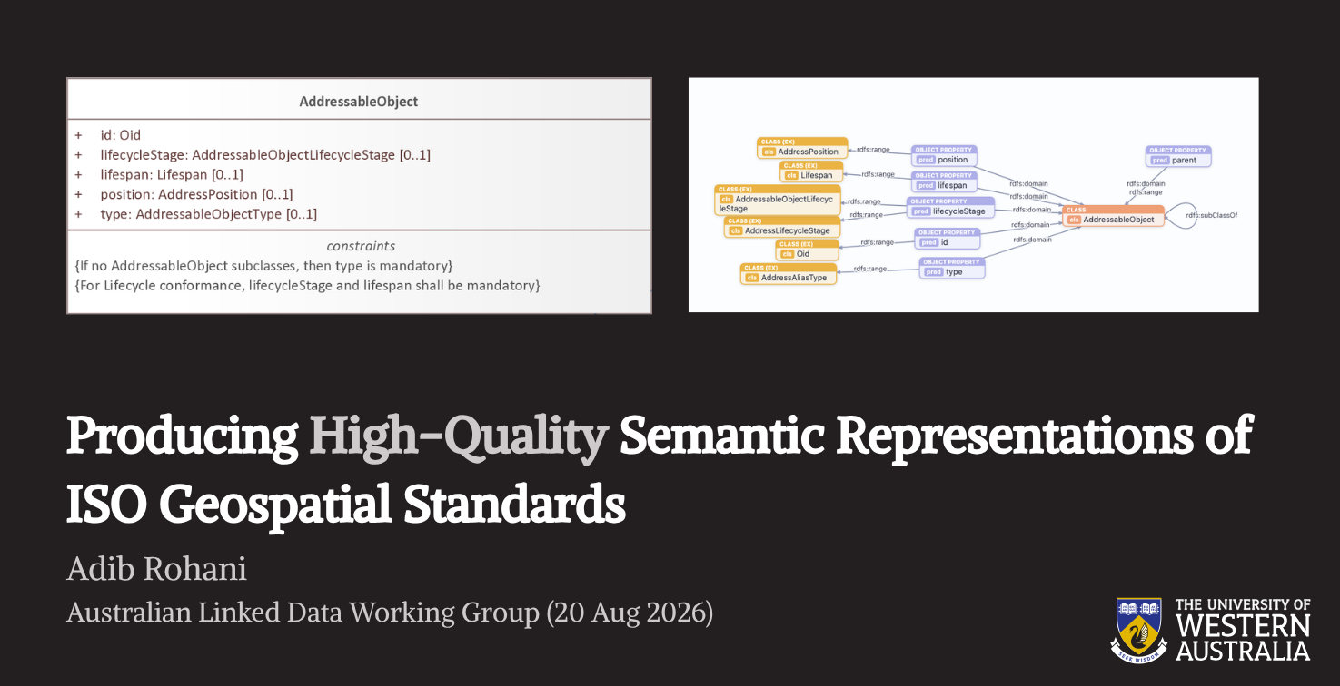

Slide 24
IDN Metadata Entry Tool
Speaker: Jamie Feiss, Uni Melbourne

Slide 25
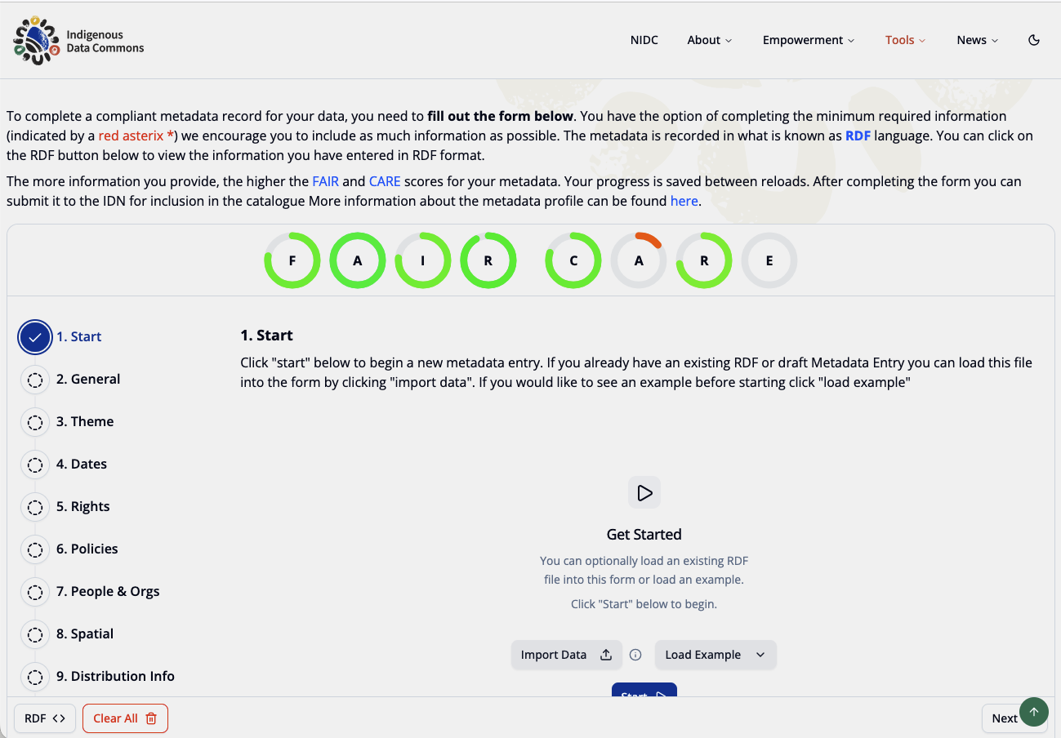

Slide 26
TERN’s continued Linked Data work
Speaker: Javier Sanchez Gomez, TERN

Slide 27
We keep working on…
TERN Ontology
  https://ternaustralia.github.io/ontology_tern/
TERN Controlled Vocabularies
  https://linkeddata.tern.org.au/prez/tern-cv/v/
EcoPlots:
  https://ecoplots.tern.org.au/
  New datasets being added
EMSA data modelling and vocabulary support (partnering with DCCEEW)
  https://emsa.tern.org.au/
  https://linkeddata.tern.org.au/prez/dawe-cv/v/
TERN DCAT profile
  https://ternaustralia.github.io/TERN-DCAT/
  CARE Principles (using IDN vocabularies)

Slide 28
Australian Government Linked Data Working Group contact:
http://www.linked.data.gov.au

